Slide 1
Efficiently drawing linear graphs
Graphical representations

Slide 2
How our teaching resources are designed for the classroom

Slide 3
I can draw a linear graph efficiently and accurately.

Slide 4
The relationship between two variables is linear if, when plotted on a pair of axes, a straight line is formed.

Slide 5

Efficiently drawing linear graphs
Plotting linear graphs
Efficiency in plotting

Slide 6




Plotting linear graphs
Aisha, Izzy and Alex are plotting graphs of equations and come across this equation, y = 5x − 7
The x and y exponents are both 1 so this graph will be linear.
We need to find some coordinates so we can plot it.
We can fill in this table of values in order to plot it.
x | −3 | −2 | −1 | 0 | 1 | 2 | 3
y
Do you agree with them all?

Slide 7
Plotting linear graphs
They are all correct but, we can look more closely at some of the language they used.
The x and y exponents are both 1 so this graph will be linear.
The x and y exponents are both 1 so this graph will be linear.
We need to find some coordinates so we can plot it.
We need to find some coordinates so we can plot it.
We can fill in this table of values in order to plot it.
We can fill in this table of values in order to plot it.
x | −3 | −2 | −1 | 0 | 1 | 2 | 3
y

Slide 8
Plotting linear graphs
They are all correct but, we can look more closely at some of the language they used.
y = 5x − 7
x | −3 | −2 | −1 | 0 | 1 | 2 | 3
y
x | −3 | −2 | −1 | 0 | 1 | 2 | 3
y | −22 | −17 | −12 | −7 | −2 | 3 | 8
When x = −3, y = 5(−3) − 7 = −22
We can fill in this table of values in order to plot it.
We can fill in this table of values in order to plot it.
When x = −2, y = 5(−2) − 7 = −17
When x = −1, y = 5(−1) − 7 = −12

Slide 9
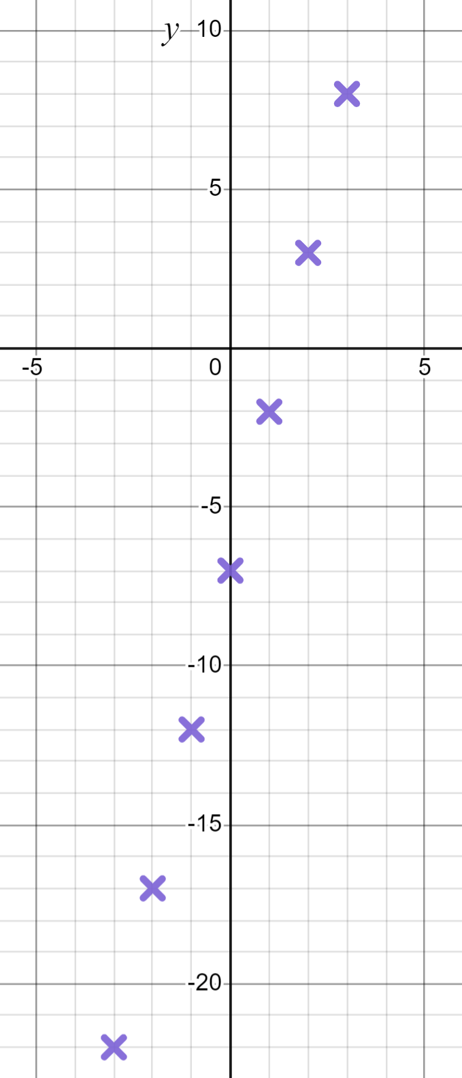
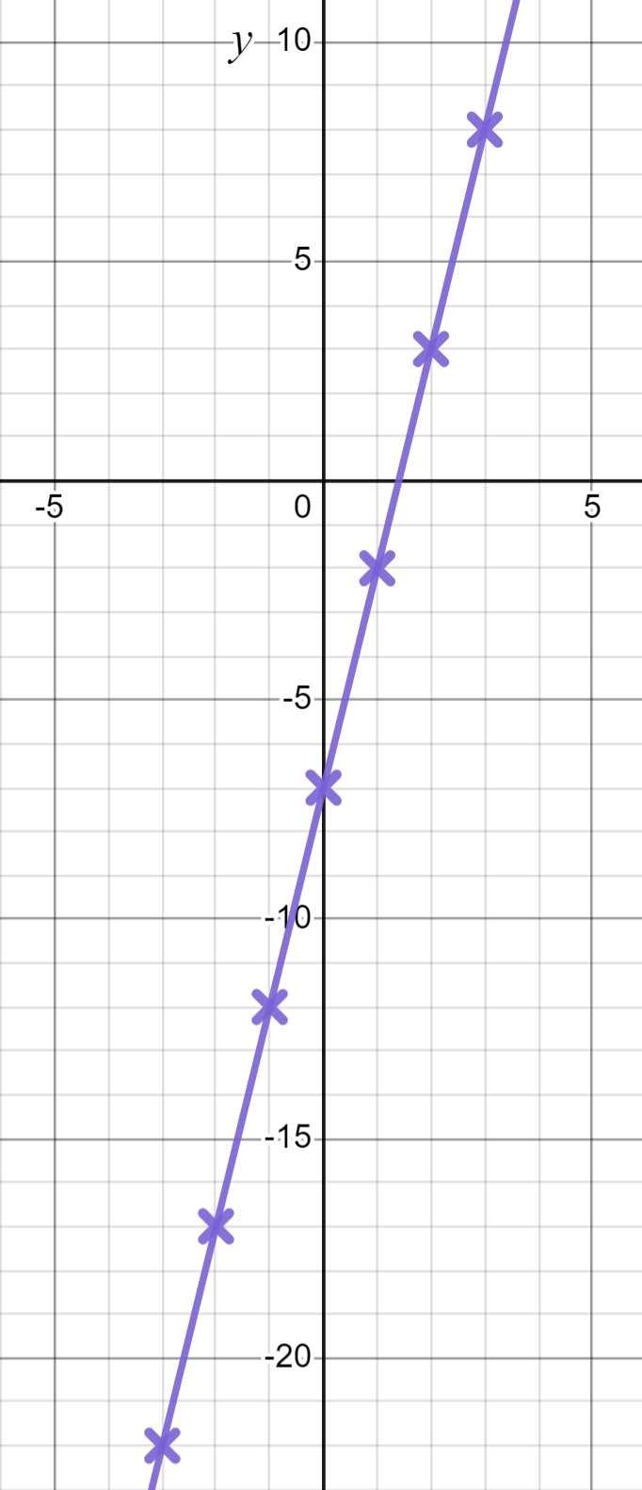
Plotting linear graphs
They are all correct but, we can look more closely at some of the language they used.
y = 5x − 7
x | −3 | −2 | −1 | 0 | 1 | 2 | 3
y
x | −3 | −2 | −1 | 0 | 1 | 2 | 3
y | −22 | −17 | −12 | −7 | −2 | 3 | 8
We can fill in this table of values in order to plot it.
We can fill in this table of values in order to plot it.

Slide 10
Plotting linear graphs
This ‘table of values’ method has some benefits.
y = 5x − 7
x | −3 | −2 | −1 | 0 | 1 | 2 | 3
y
x | −3 | −2 | −1 | 0 | 1 | 2 | 3
y | −22 | −17 | −12 | −7 | −2 | 3 | 8
+5
+5
+5
+5
+5
+5
+5
+5
✖
(0,−7)
The gradient is very visible.
The y-intercept is in this table.

Slide 11
Plotting linear graphs
Aisha and Izzy have some useful comments for Alex.
That was a lot of work!
You know this equation makes a straight line…
y = 5x − 7
So we only need some coordinates. You didn’t have to find seven of them.
How many coordinates do I need then?
What do you think?

Slide 12
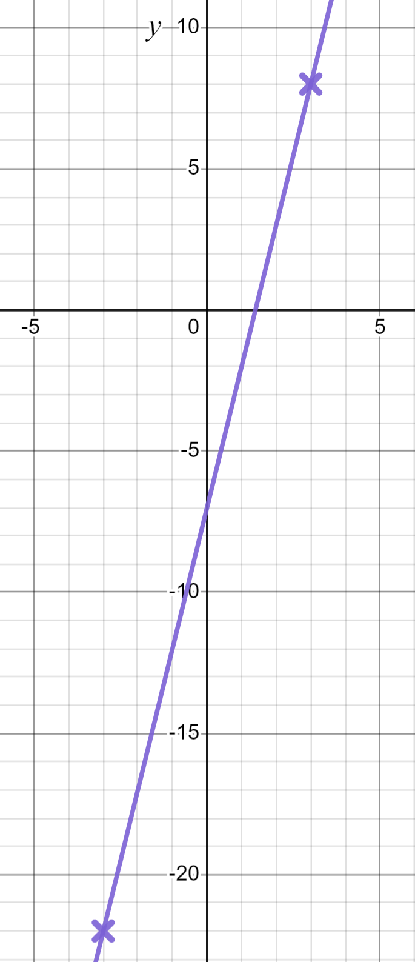
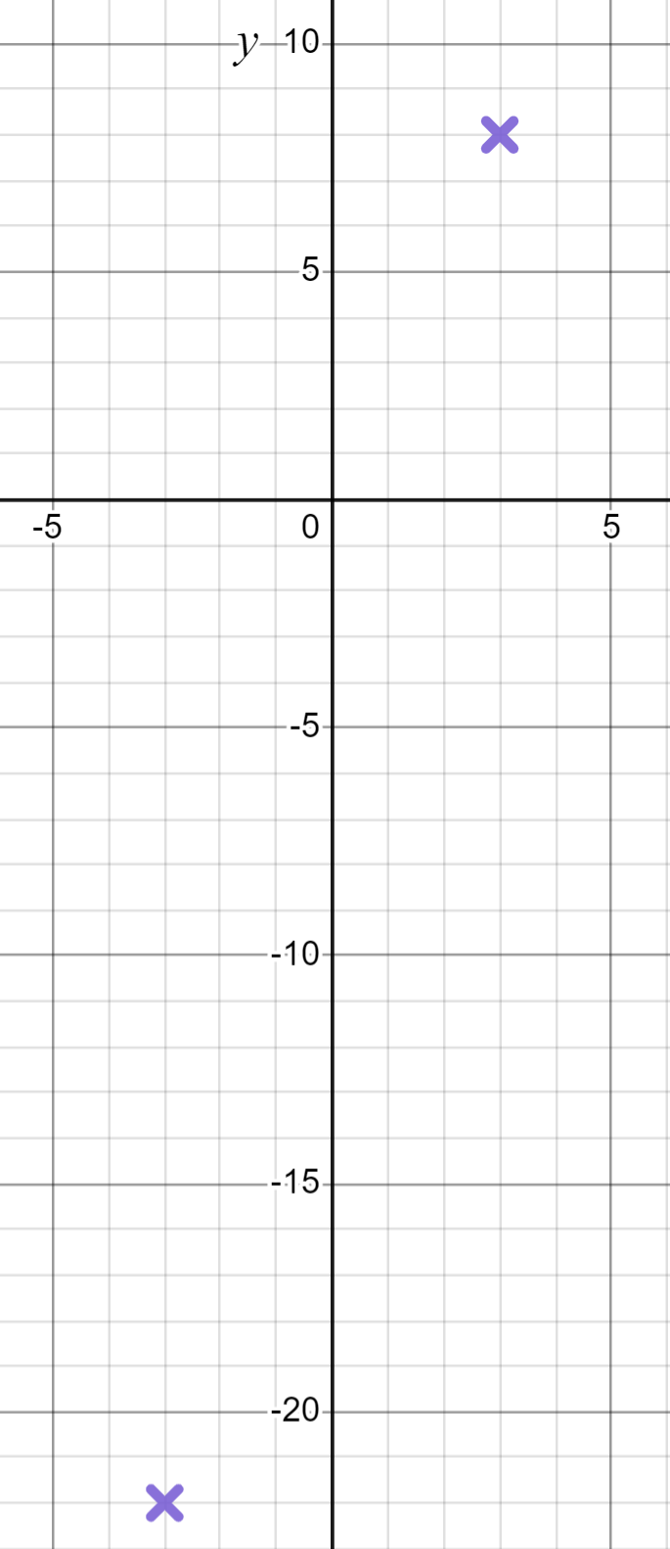
Plotting linear graphs
Aisha and Izzy have some useful comments for Alex.
If you know any two coordinates you can draw the line.
y = 5x − 7
When x = −3, y = 5(−3) − 7 = −22
When x = 3, y = 5(3) − 7 = 8
That’s the line and in far less time!

Slide 13
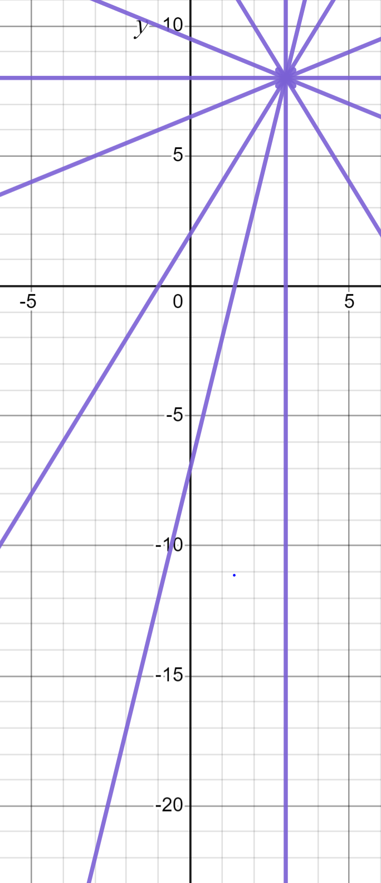
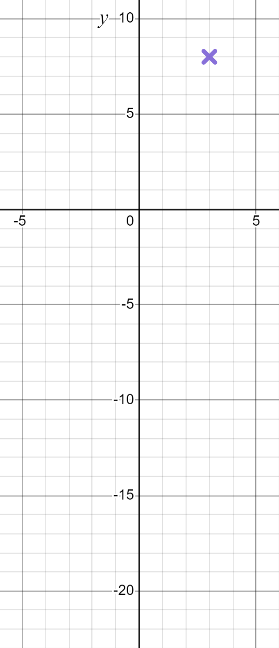
Plotting linear graphs
What do you think?
y = 5x − 7
No Alex. There are infinite lines that could go through the coordinate (3, 8). You need two coordinates to confirm which one, unique line it is.
Could I do it with just one coordinate?
Thanks Izzy!

Slide 14

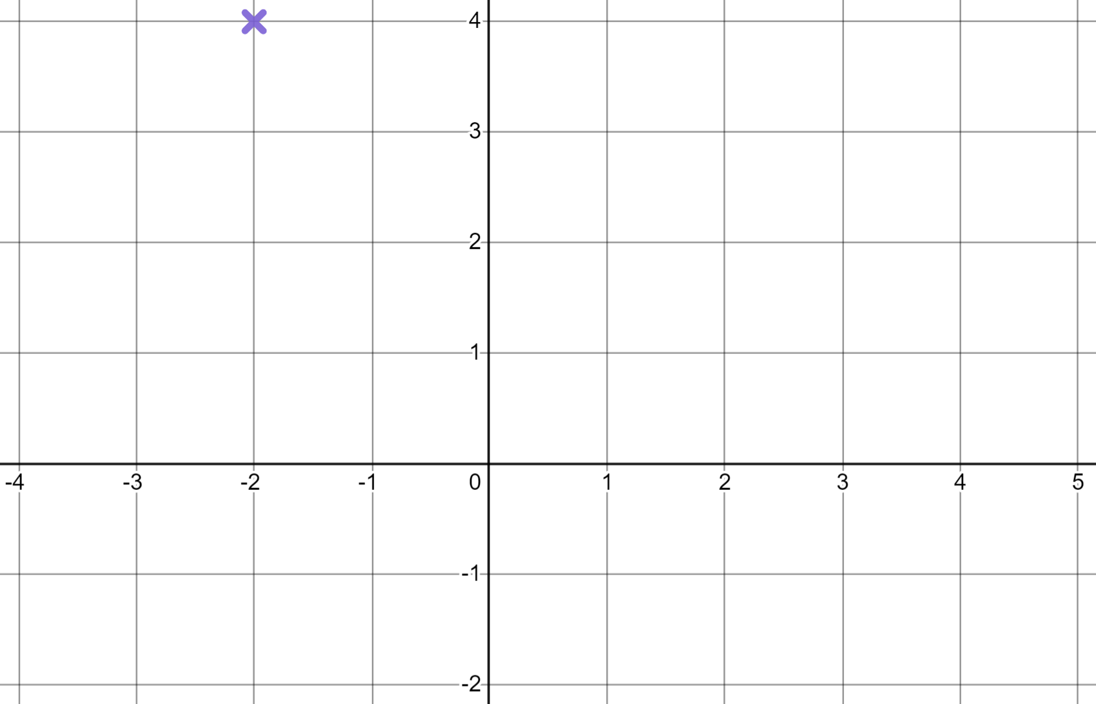
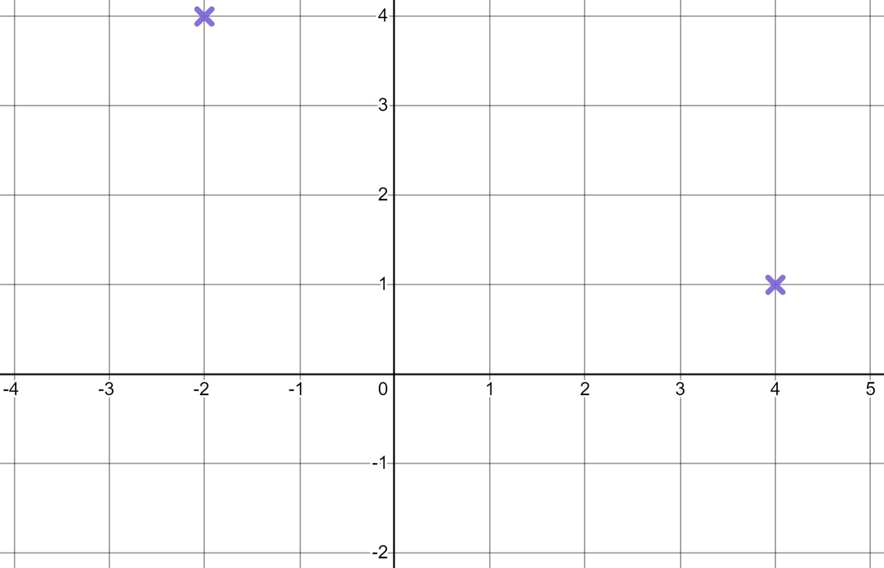
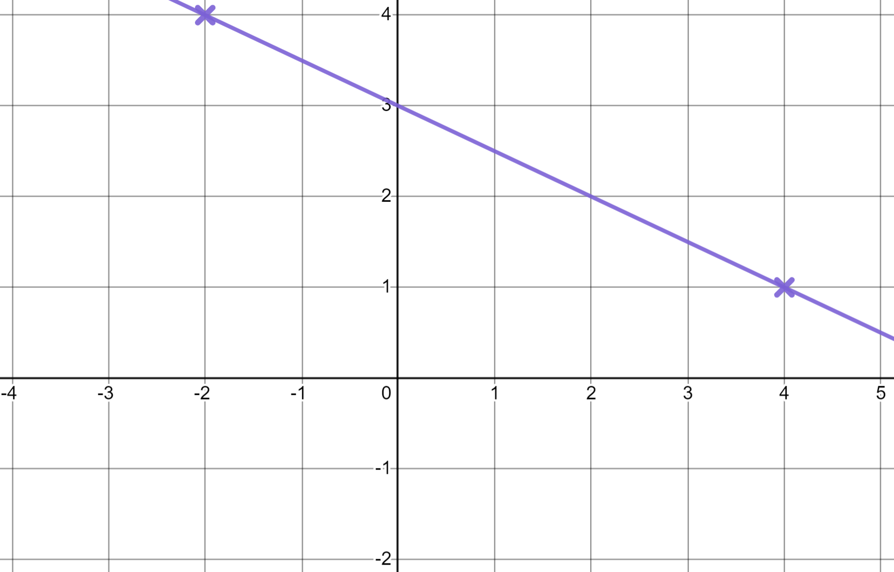
Plotting linear graphs
What is the minimum number of coordinates we need to plot the graph of a linear equation?
1
A linear graph can’t be drawn with just one coordinate. It could be any one of an infinite number of lines.
2
But once we have two coordinates…
4
It is this line and only this line.
7
Any more coordinates would be less efficient.

Slide 15
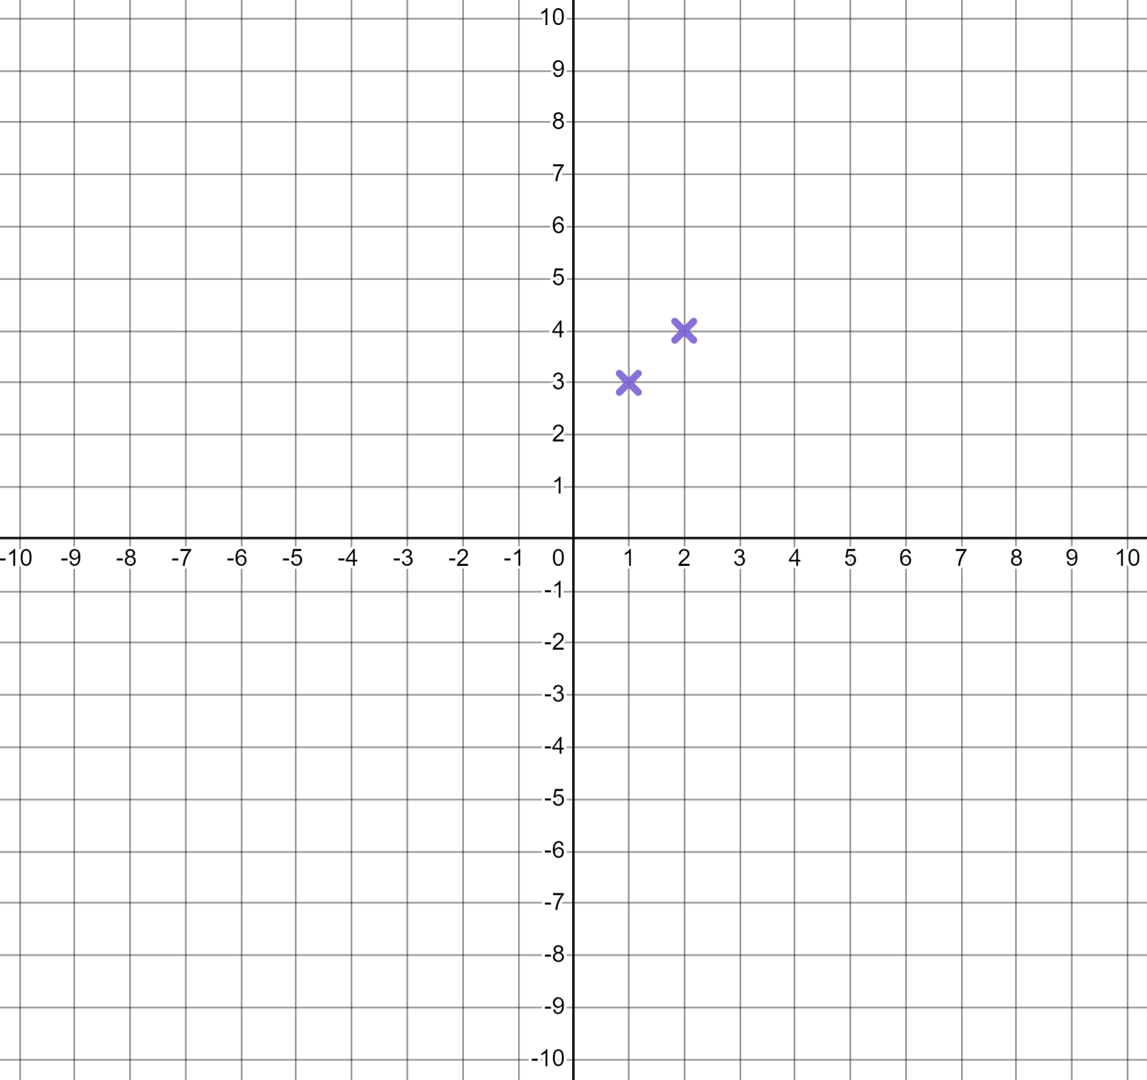
Plotting linear graphs
Thanks to Aisha and Izzy, Alex is now far more efficient when plotting the equation y = x + 2
I don’t need a full table. I just need any two coordinates.
(1, 3)
(2, 4)
Whilst I love your efficiency don’t forget that accuracy is also important in maths.

Slide 16
Plotting linear graphs
Oh no! (−10,−7) wouldn’t be on the line y = x + 2
y = x + 2
Accuracy is important. By choosing two closely neighbouring coordinates you lost accuracy as your line reached extremities.
✖
(−10,−7)

Slide 17
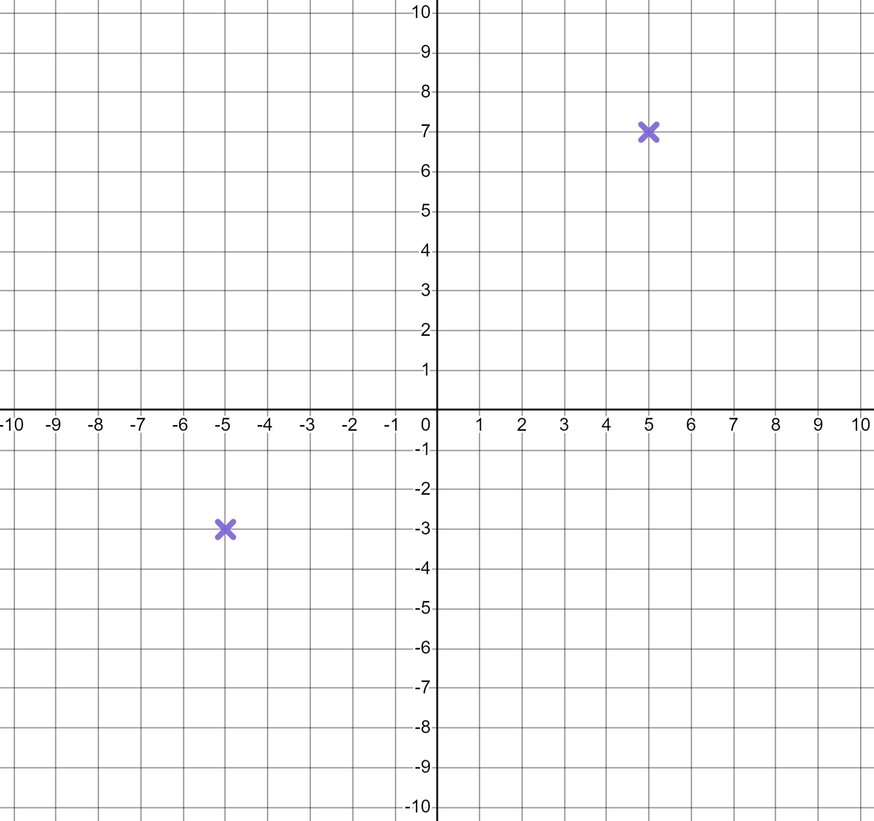
Plotting linear graphs
y = x + 2
Okay, I’ll use (−5,−3) and (5,7)
If you are plotting in this range of x values choose two coordinates that have more distance between them.
✖
(−10,−7)

Slide 18
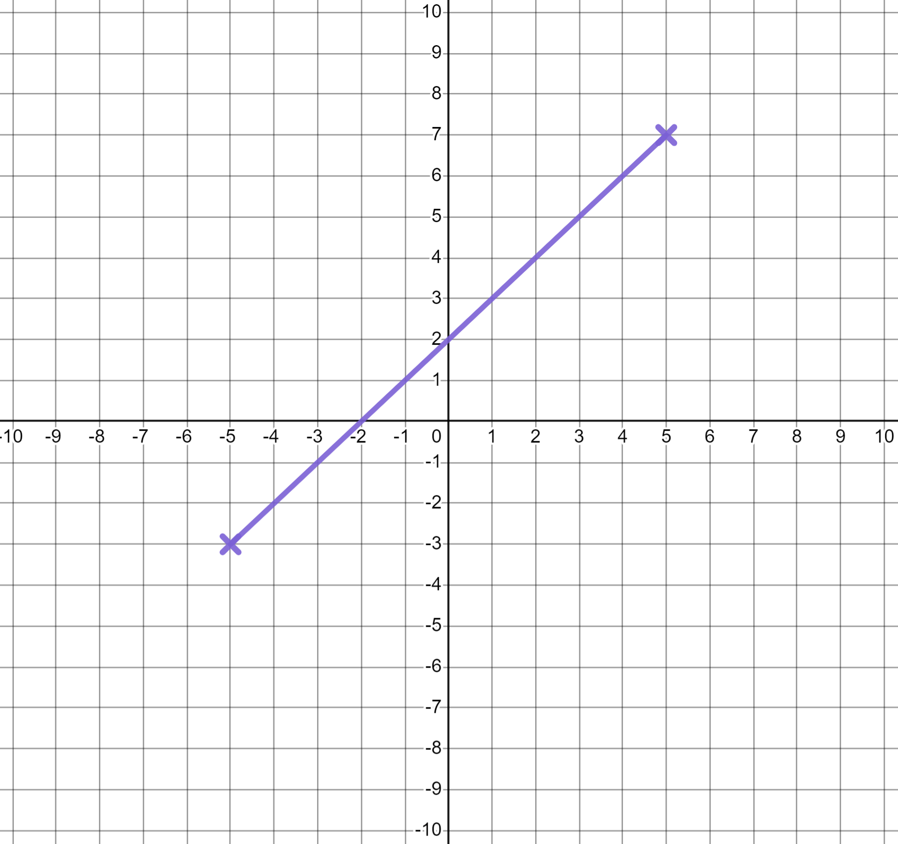
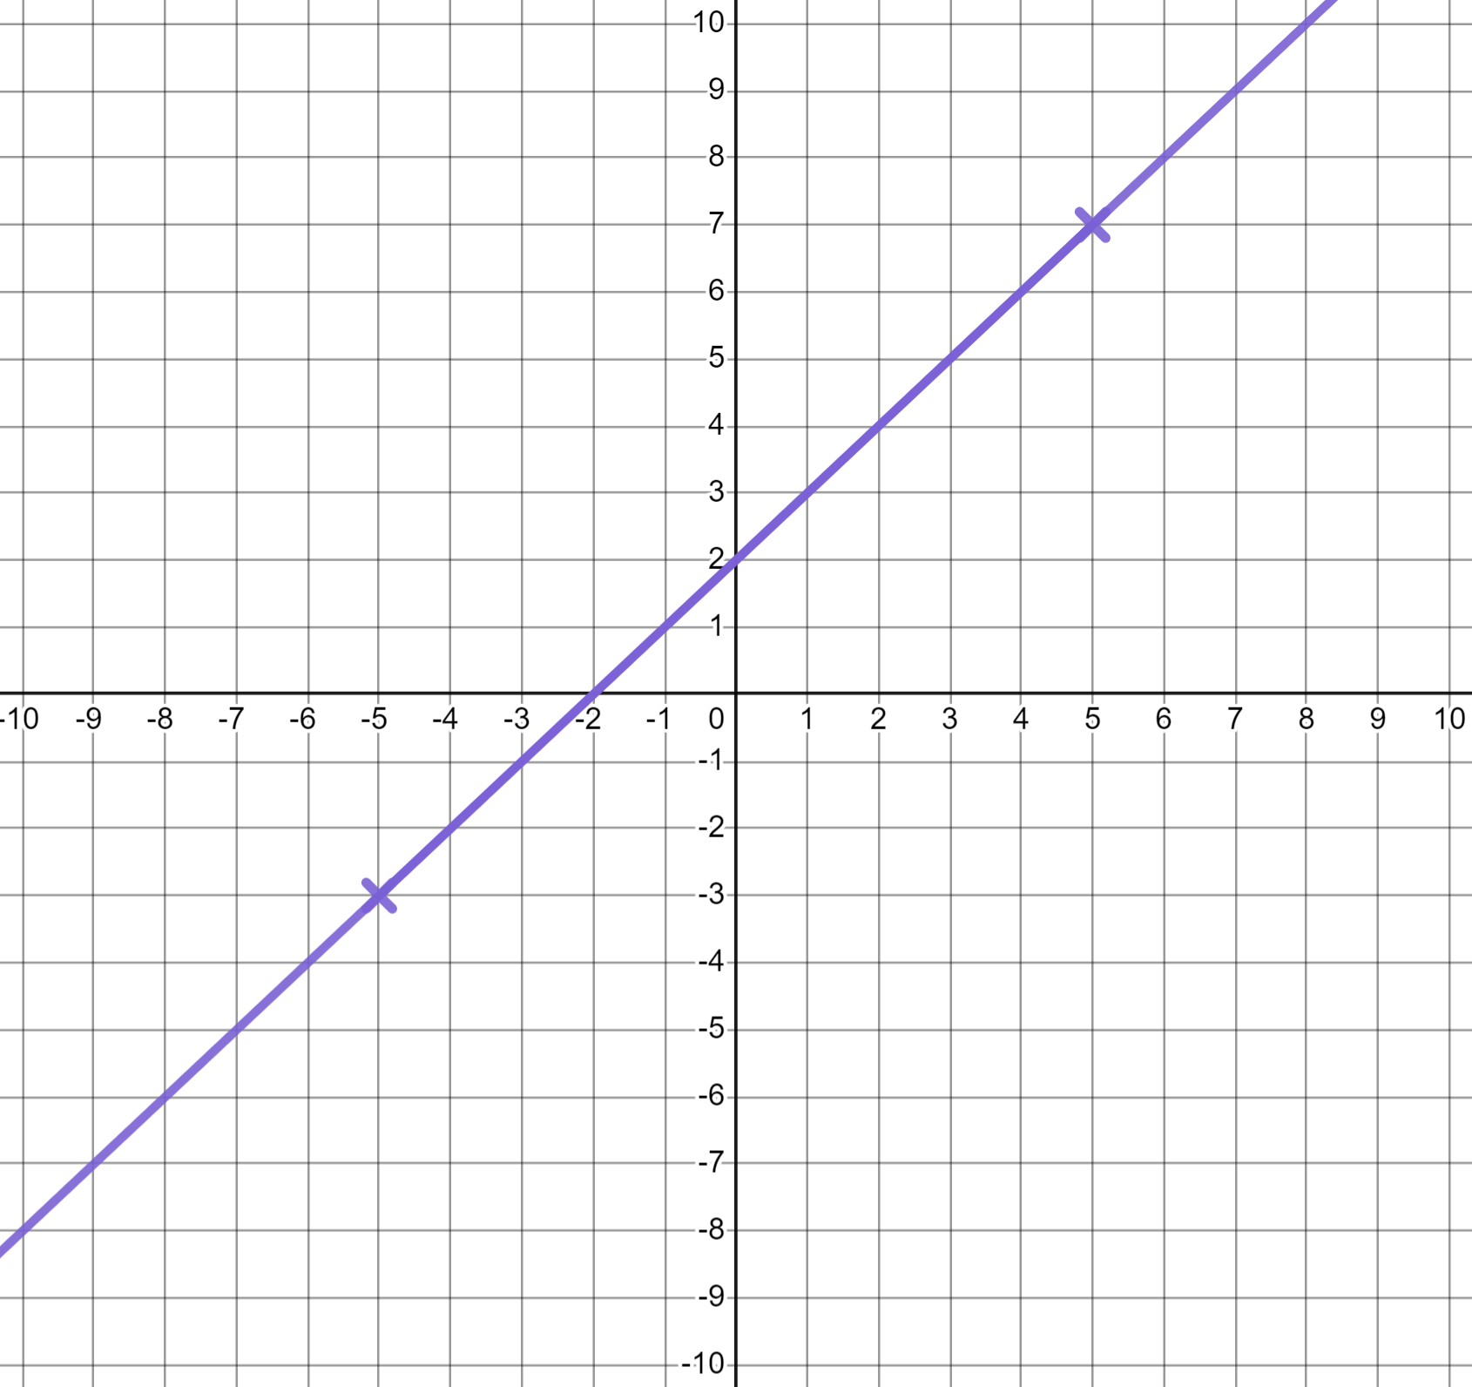
Plotting linear graphs
y = x + 2
Okay, I’ll use (−5,−3) and (5,7)
Perfect. Now when you join those two coordinates you’ll get a clearer picture of the gradient which will enable you to extend your line more accurately.

Slide 19
Plotting linear graphs
When plotting linear graphs using two coordinates we can use any two coordinates.
It’s a line. When we know any two coordinates we can draw a line through them and beyond.
Whilst two coordinates is sufficient we need to ensure there is a sufficient distance between them for the accuracy we need.

Slide 20
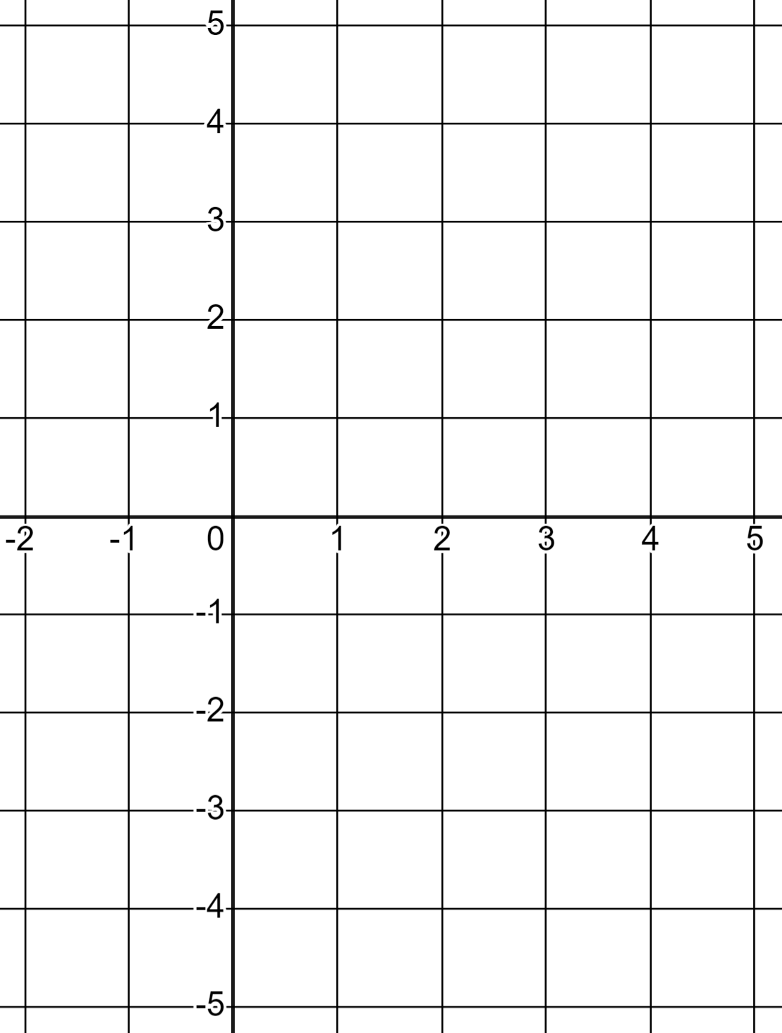
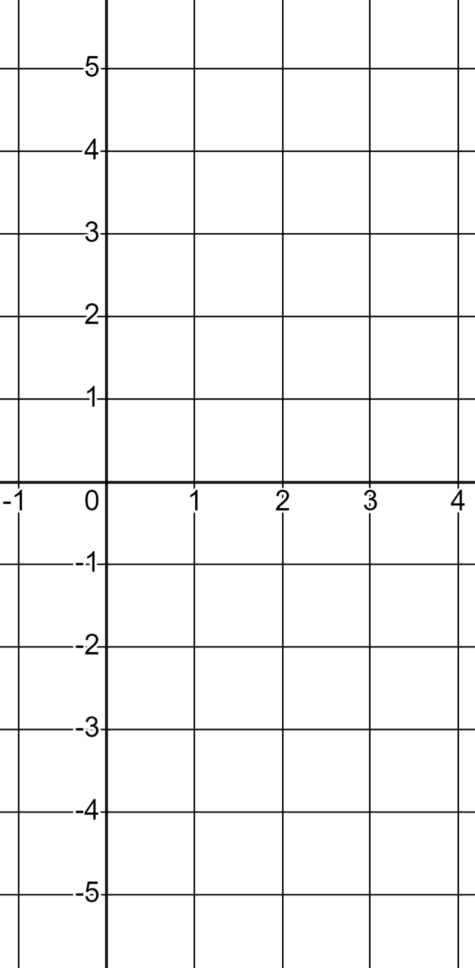
Plotting linear graphs
1) In each case fill in the missing coordinate and draw the respective linear graph.
a) y = 2x − 4
b) y = 5 − 3x
(0, __ )
(0, __ )
(4, __ )
(3, __ )

Slide 21
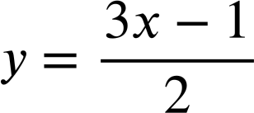
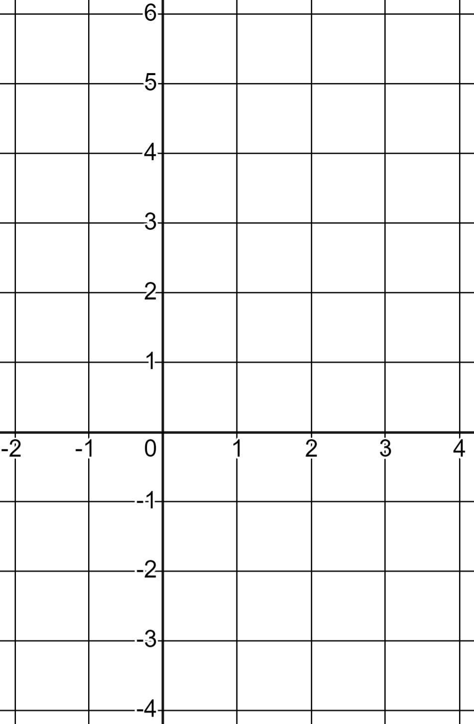
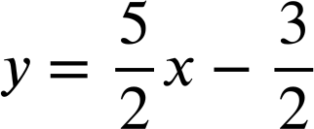
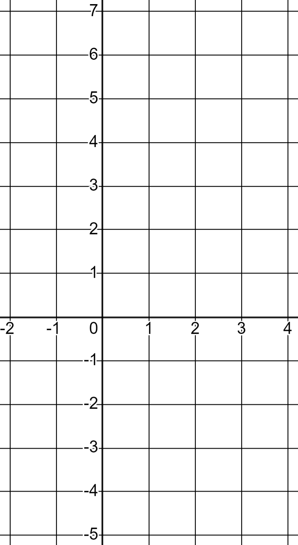
Plotting linear graphs
1) In each case fill in the missing coordinate and draw the respective linear graph.
c)
d)
(−1, __ )
(−1, __ )
(3, __ )
(3, __ )

Slide 22
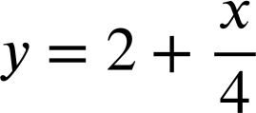
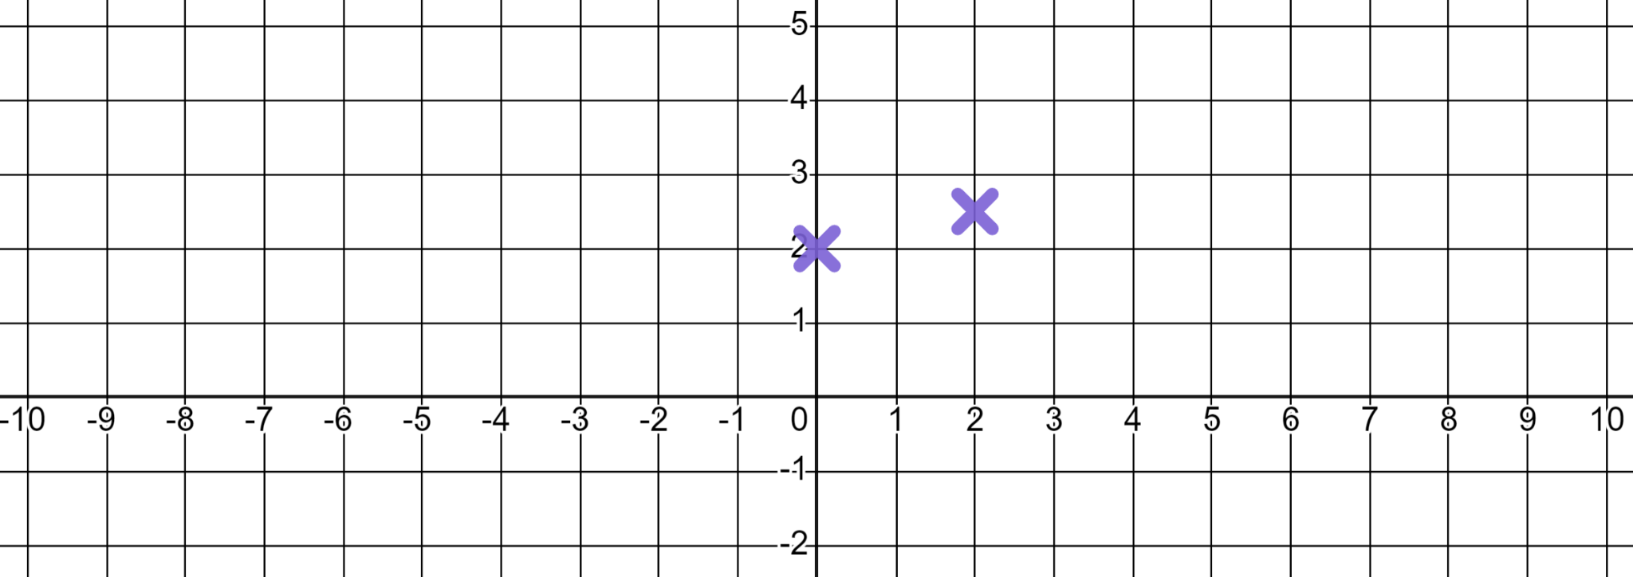
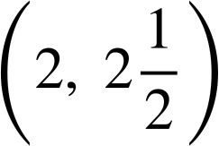
Plotting linear graphs
2) Alex plots the linear graph of using these two coordinates.
(0, 2)
(−9, 0)
✖
Use the coordinate (−9, 0) to demonstrate that they are wrong and write a sentence advising what they might do better.

Slide 23
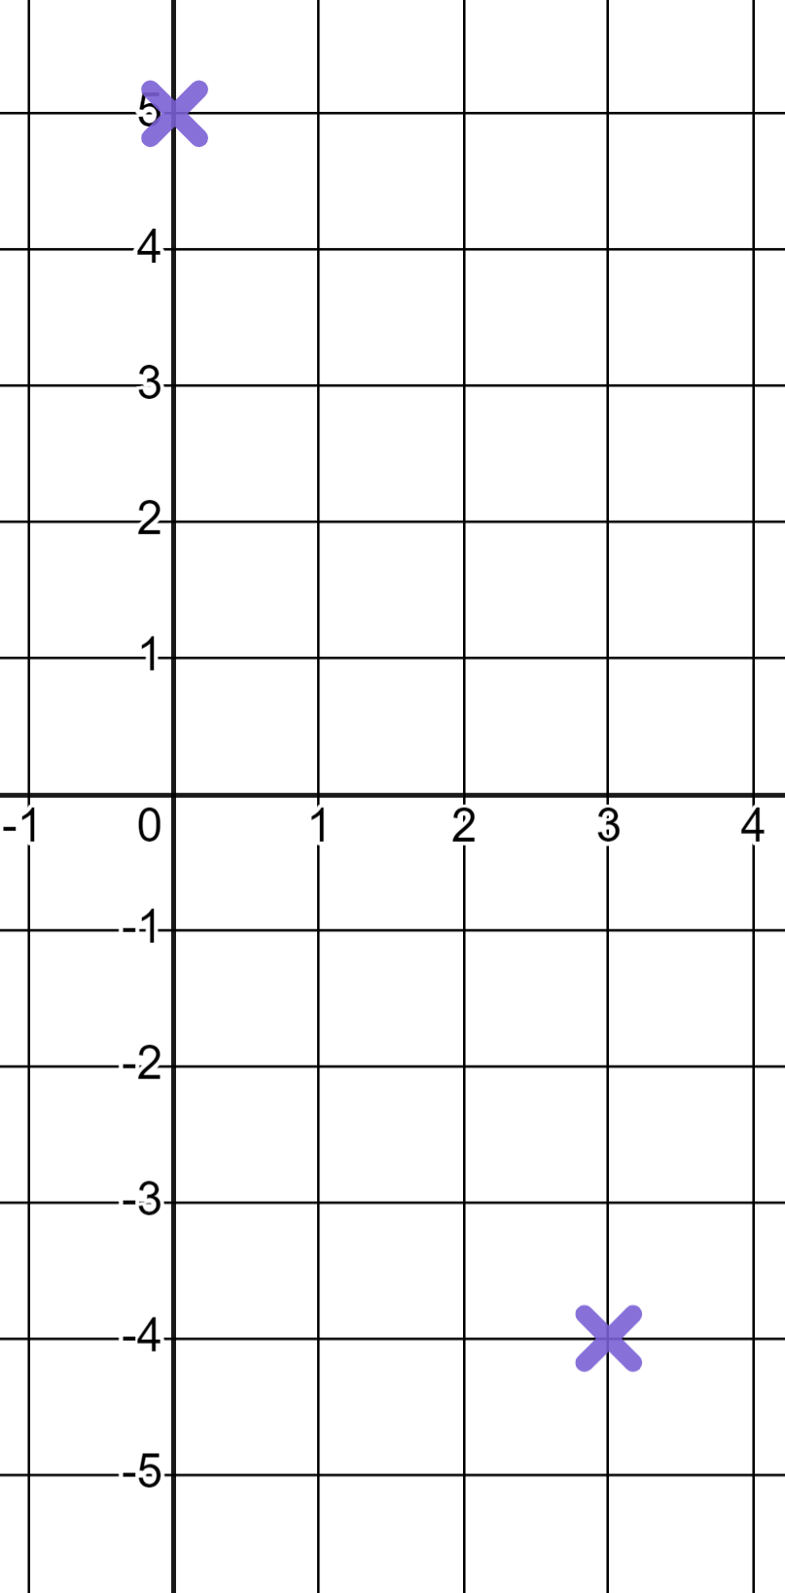
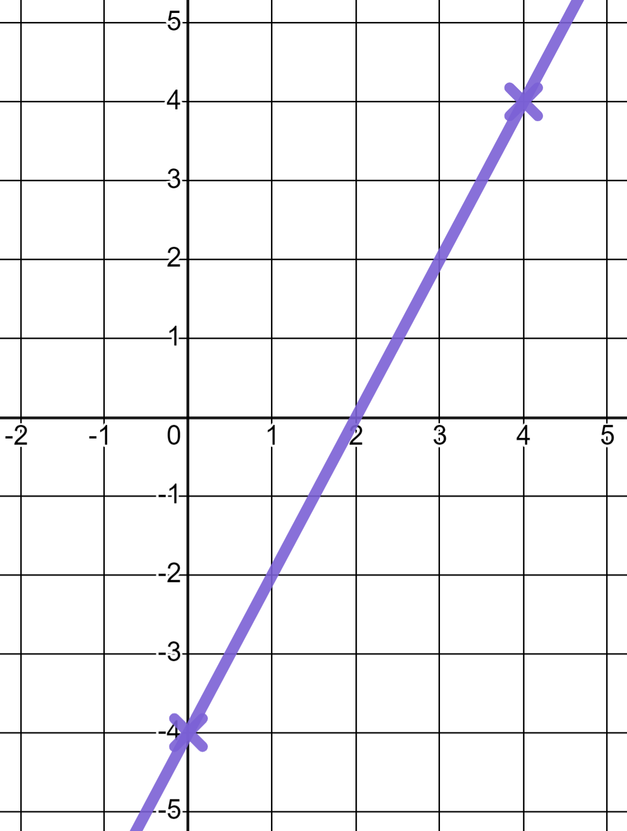
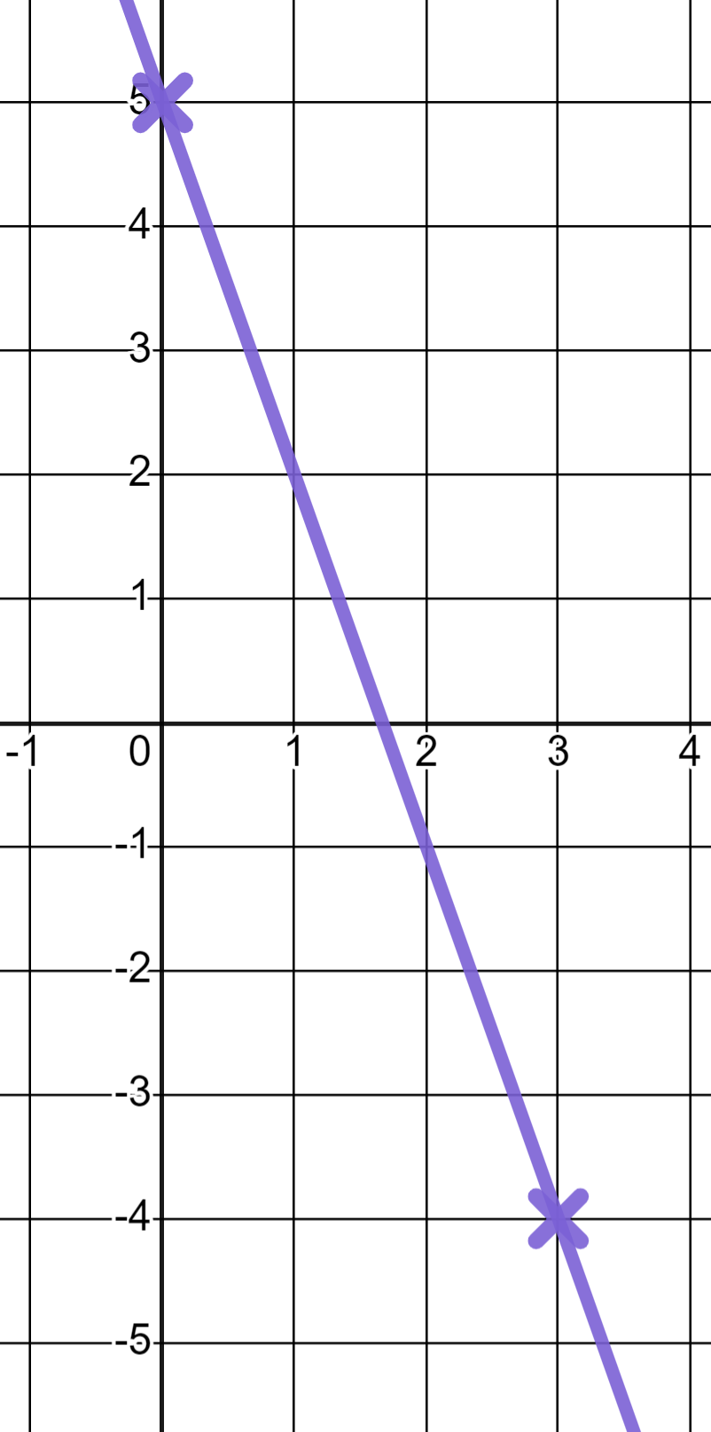
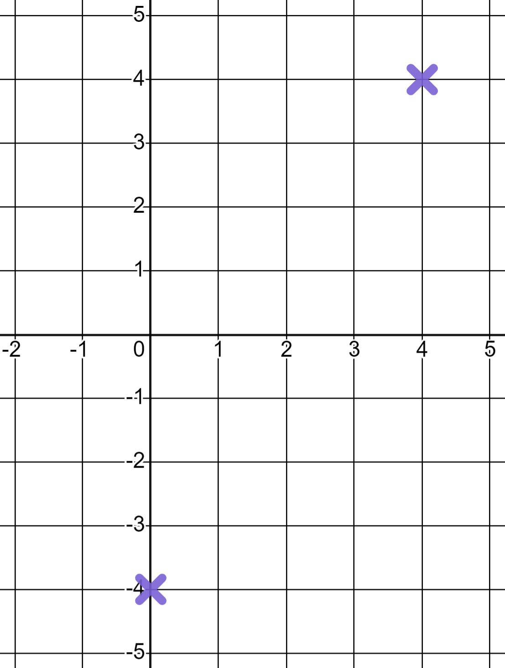
Plotting linear graphs
1) In each case fill in the missing coordinate and draw the respective linear graph.
a) y = 2x − 4
b) y = 5 − 3x
(0, __ )
(0, __ )
−4
5
(4, __ )
(3, __ )
4
−4

Slide 24
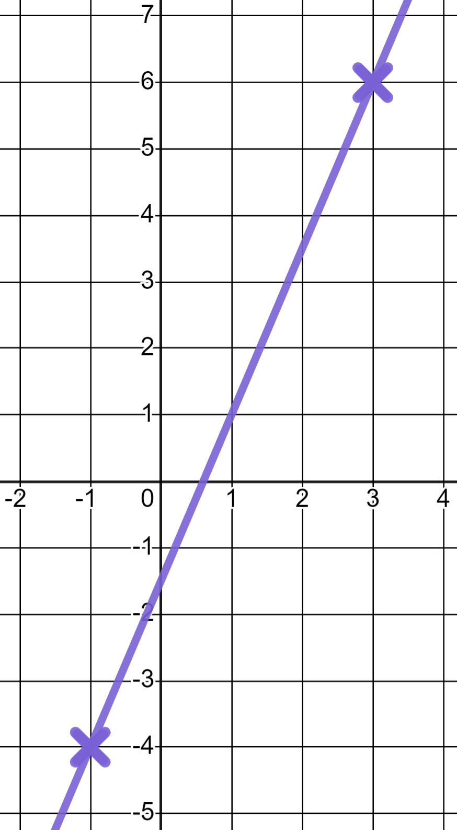
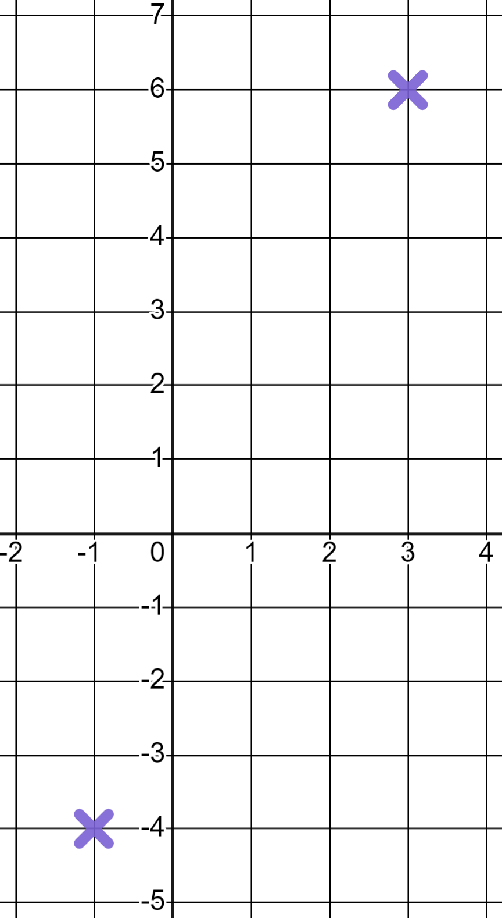
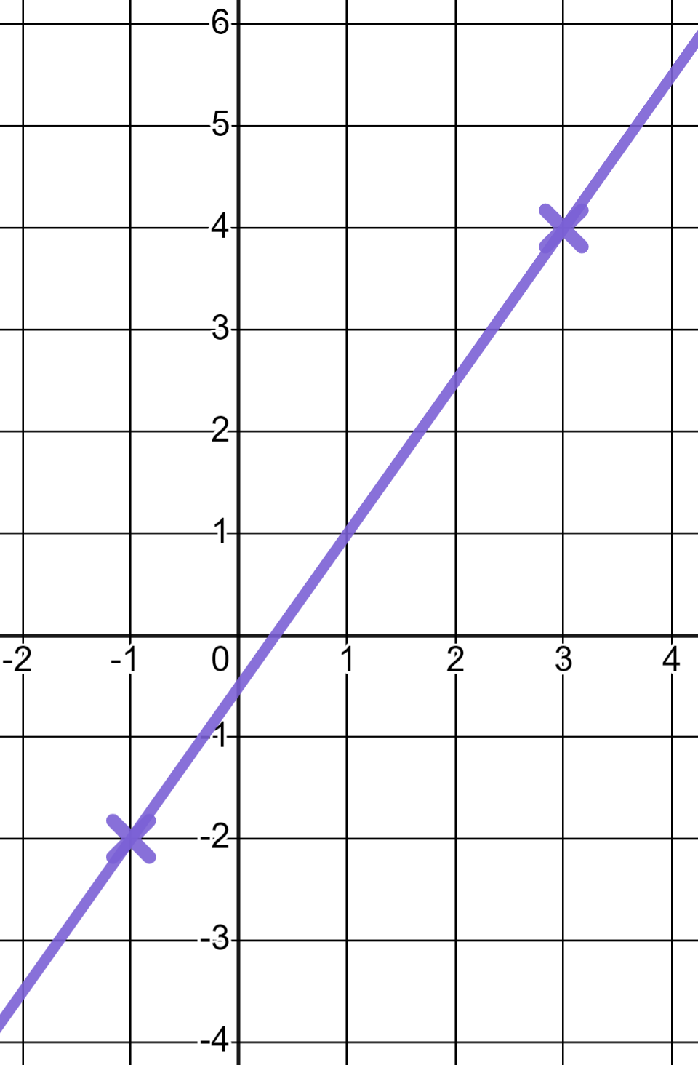
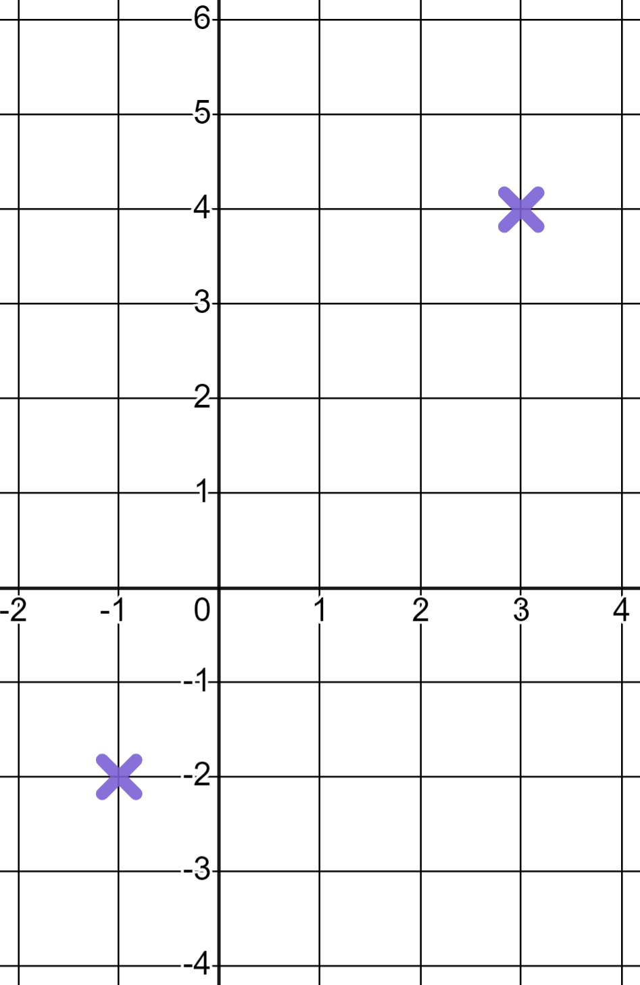
Plotting linear graphs
1) In each case fill in the missing coordinate and draw the respective linear graph.
c)
d)
(−1, __ )
(−1, __ )
−2
−4
(3, __ )
(3, __ )
4
6

Slide 25
Plotting linear graphs
2) Alex plots the linear graph of using these two coordinates.
(0, 2)
(−9, 0)
✖
Use the coordinate (−9, 0) to demonstrate that they are wrong and write a sentence advising what they might do better.

Slide 26
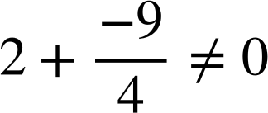
Plotting linear graphs
2) Alex plots the linear graph of using these two coordinates.
(0, 2)
(−9, 0)
✖
so (−9, 0) can not be a coordinate on the line
You might have written:
“Start with two more distant coordinates to increase accuracy”

Slide 27
Efficiently drawing linear graphs
Plotting linear graphs
Efficiency in plotting

Slide 28
Efficiency in plotting
We won’t always see linear equations in the form y = mx + c We often see the form ax + by = c
For example, the linear equation 5x + 3y = 15
A table of values is possible but it’s really inefficient.
x | −3 | −2 | −1 | 0 | 1 | 2 | 3
y
e.g. x = −2, 5(−2) + 3y = 15
This y value is awkward and unnecessary.

Slide 29
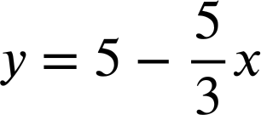
Efficiency in plotting
We won’t always see linear equations in the form y = mx + c We often see the form ax + by = c
For example, the linear equation 5x + 3y = 15
We could rearrange into the form y = mx + c
But that’s not a nice gradient to sketch!

Slide 30
Efficiency in plotting
We won’t always see linear equations in the form y = mx + c We often see the form ax + by = c
For example, the linear equation 5x + 3y = 15
For accuracy and efficiency there are two very obvious coordinates we can find to plot this graph.
When x = 0
(0, 5)
When y = 0
(3, 0)
5(0) + 3y = 15
5x + 3(0) = 15
3y = 15
5x = 15
y = 5
x = 3

Slide 31
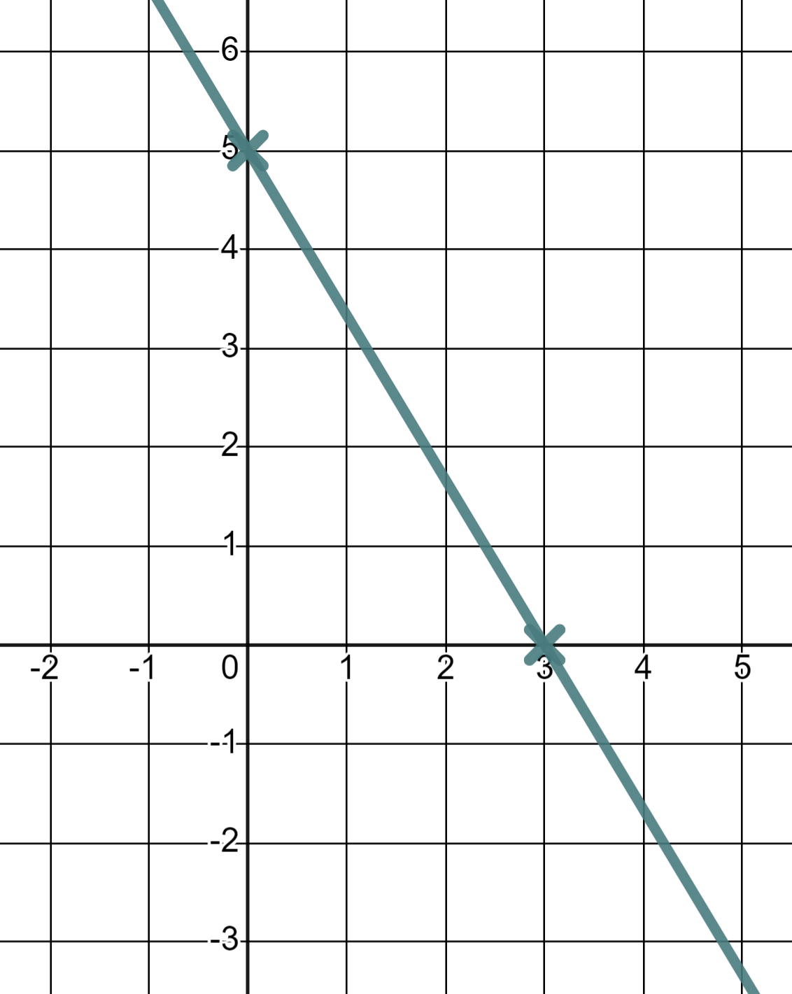
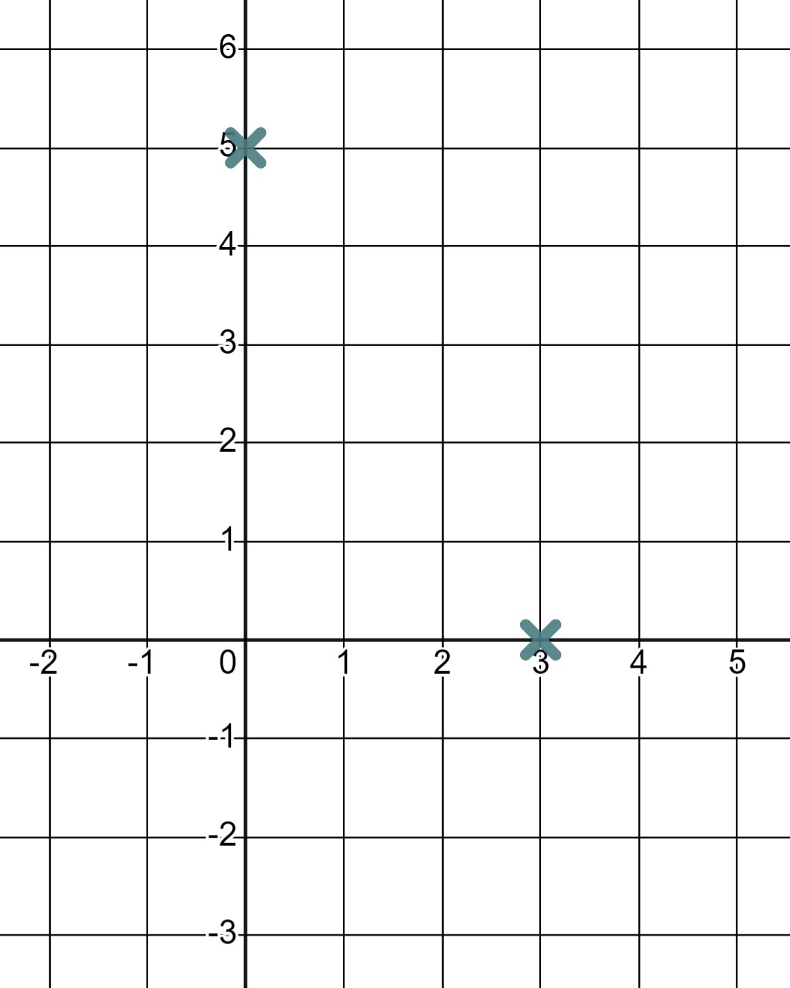
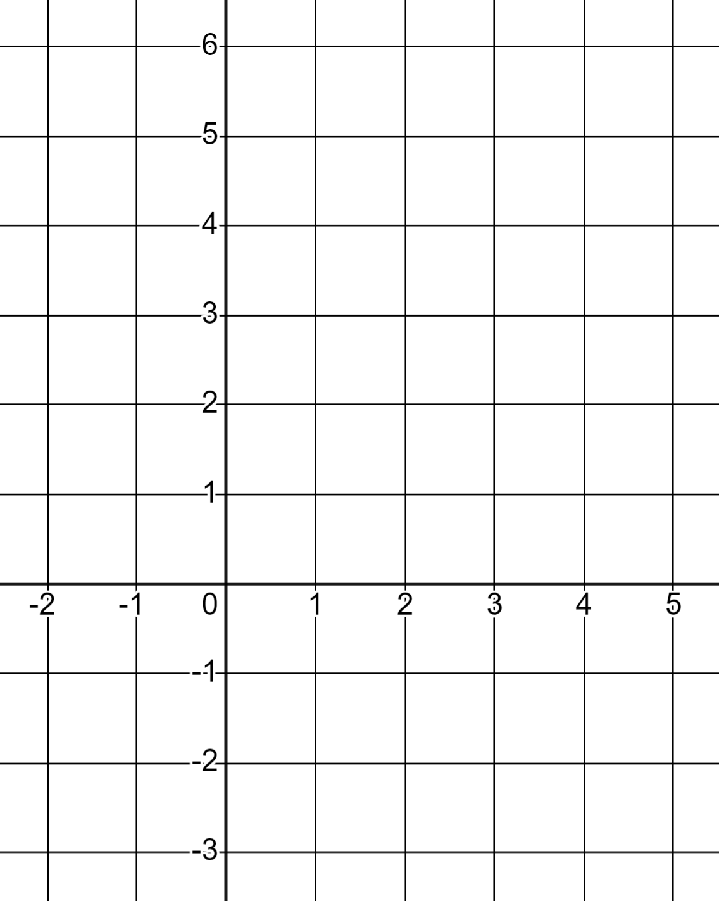
Efficiency in plotting
The linear equation 5x + 3y = 15
When x = 0
(0, 5)
When y = 0
(3, 0)

Slide 32
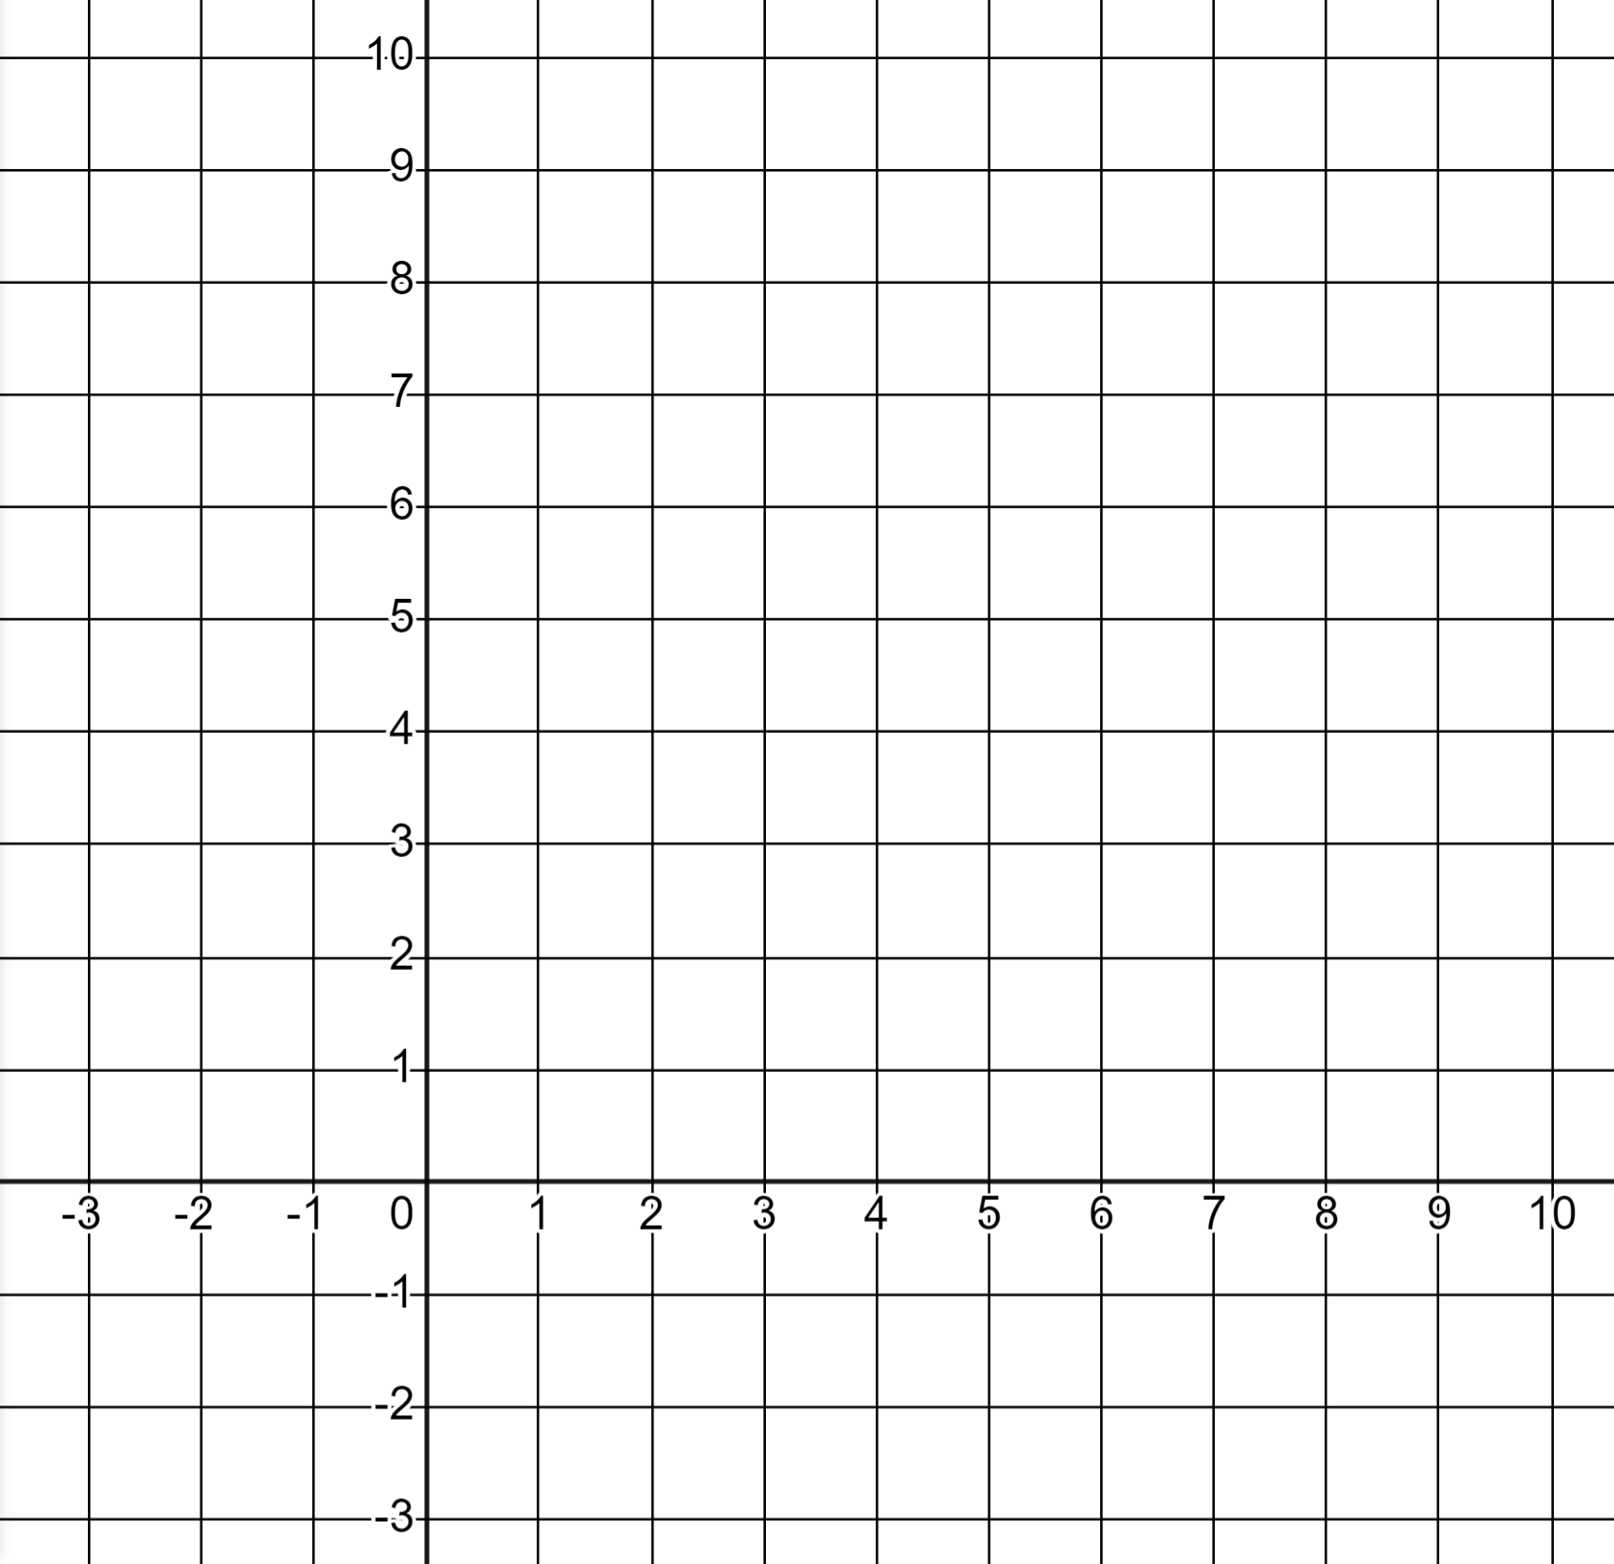
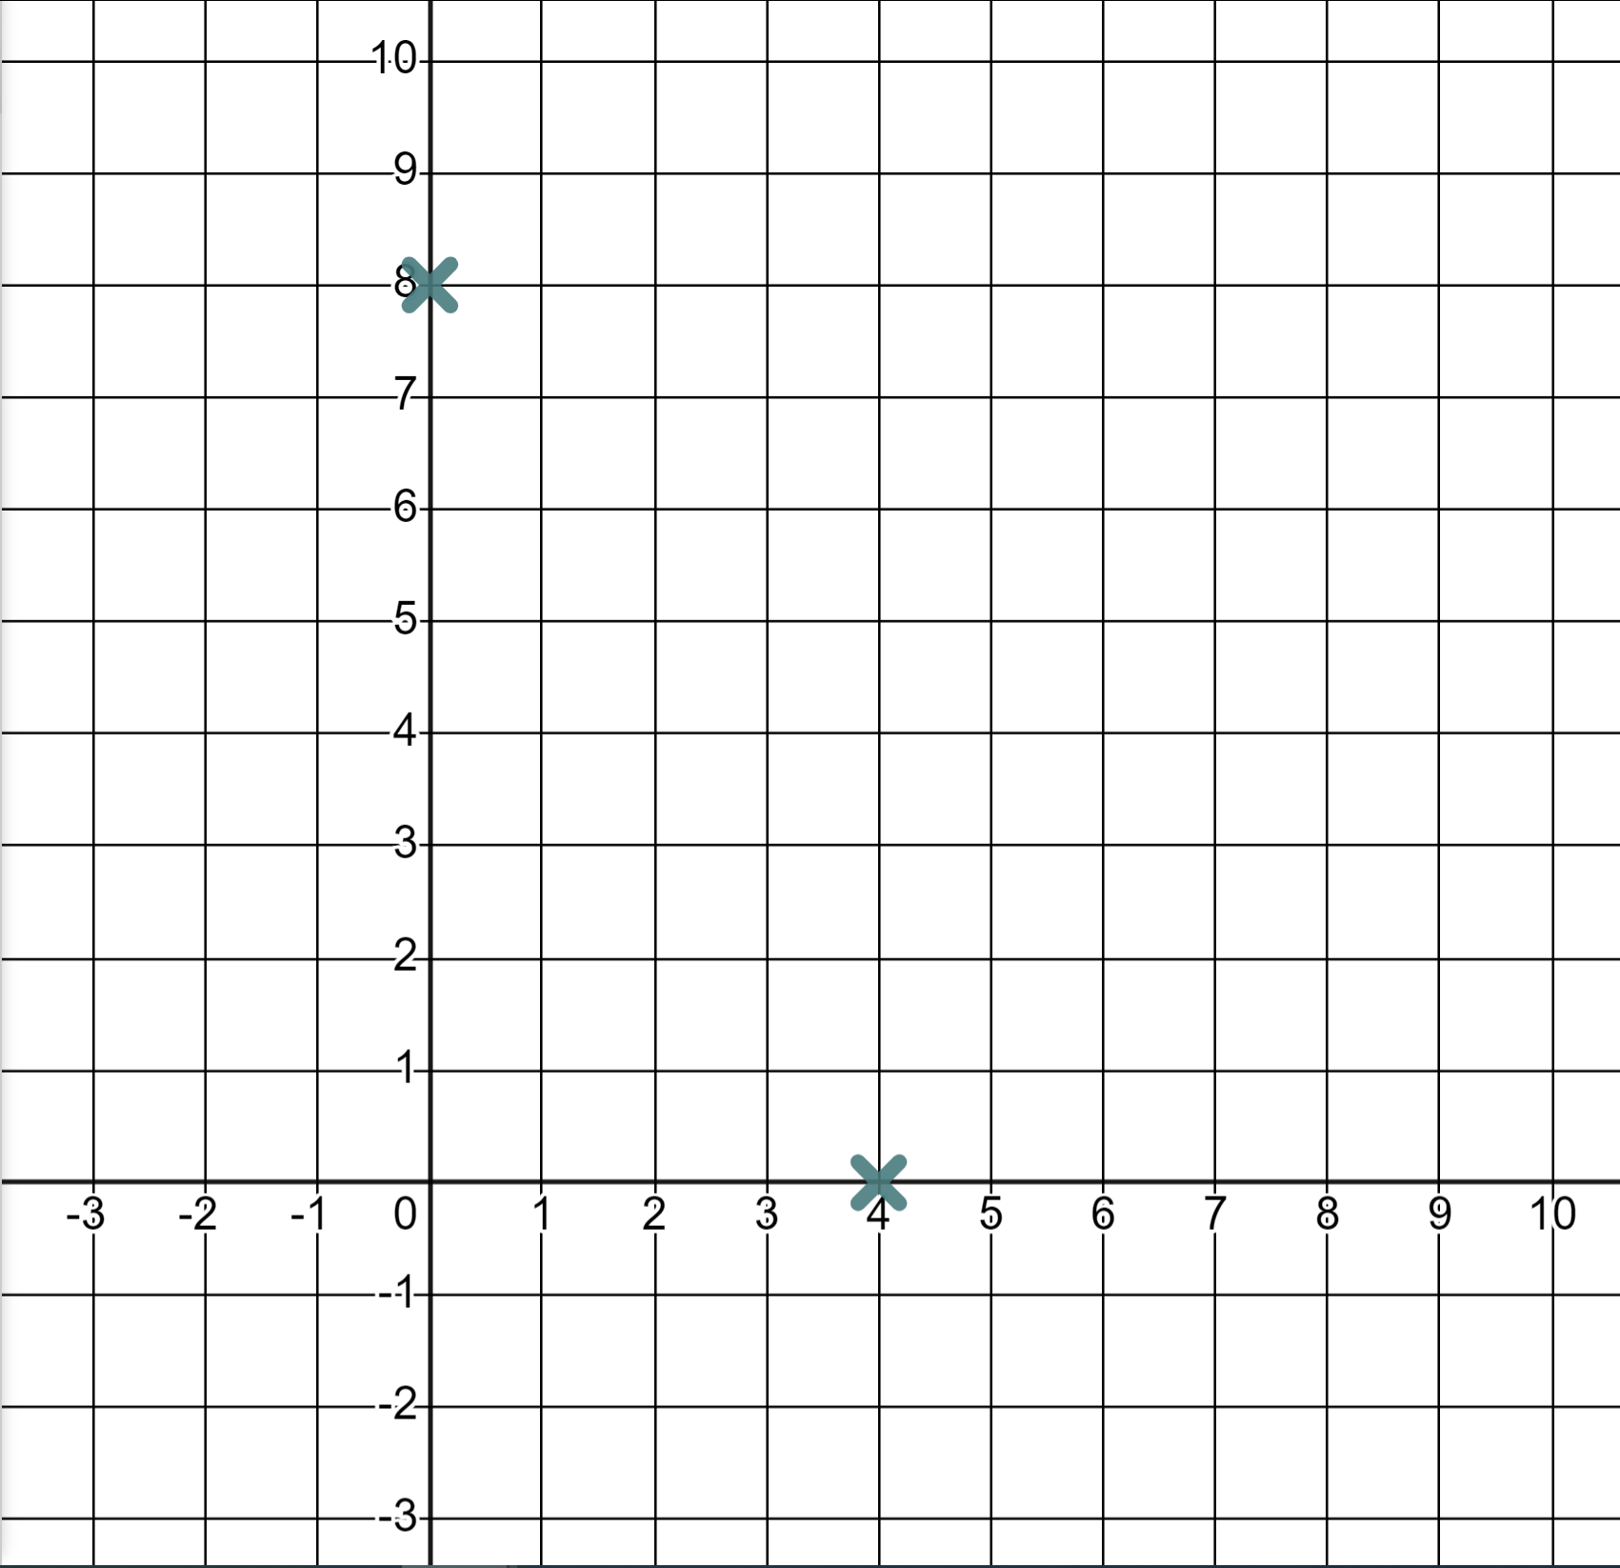
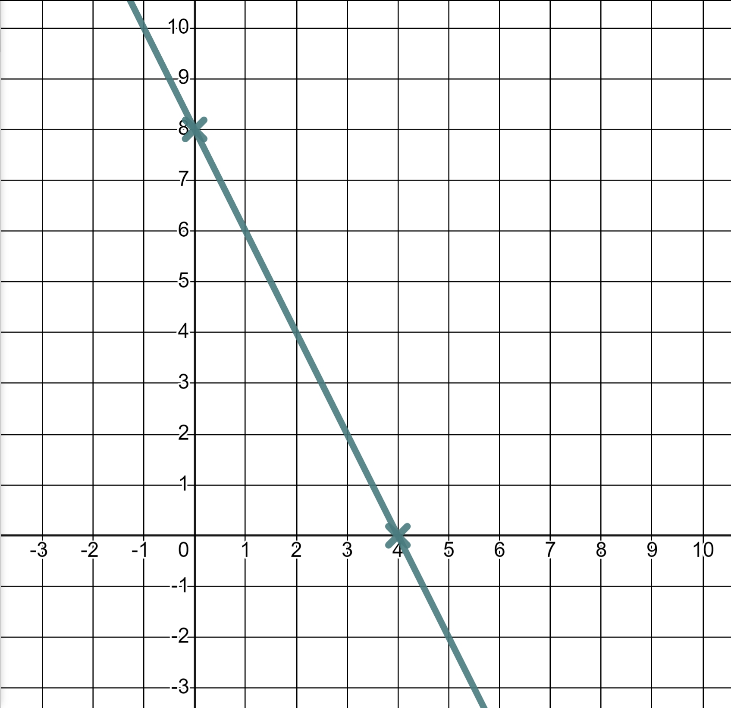
Efficiency in plotting
Complete the coordinate values for when x = 0 and when y = 0 and draw the linear equation 4x + 2y = 16
When x = 0
4(0) + 2y = 16
(0, 8)
2y = 16
y = 8
When y = 0
4x + 2(0) = 16
(4, 0)
4x = 16
x = 4

Slide 33
Efficiency in plotting
Sometimes we will see the form y = mx + c but the numbers will not be integer values.
For example, the linear equation y = 0.4x + 1.2
A table of values is again possible but it’s inefficient…
x | −3 | −2 | −1 | 0 | 1 | 2 | 3
y
x | −3 | −2 | −1 | 0 | 1 | 2 | 3
y | 0 | 0.4 | 0.8 | 1.2 | 1.6 | 2 | 2.4
And these non-integer y-coordinates might be difficult to plot accurately!

Slide 34
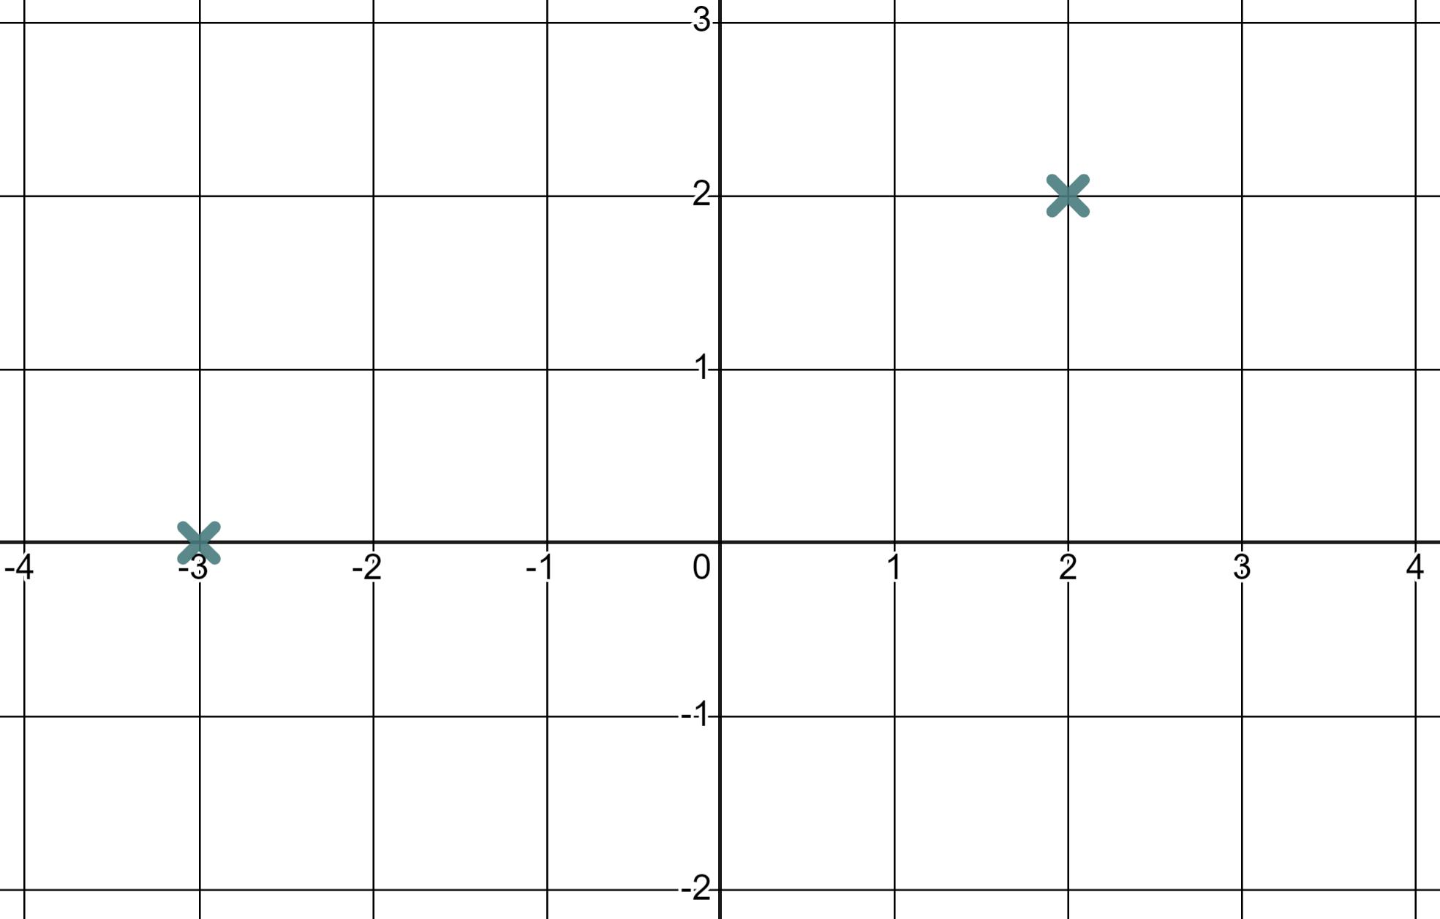
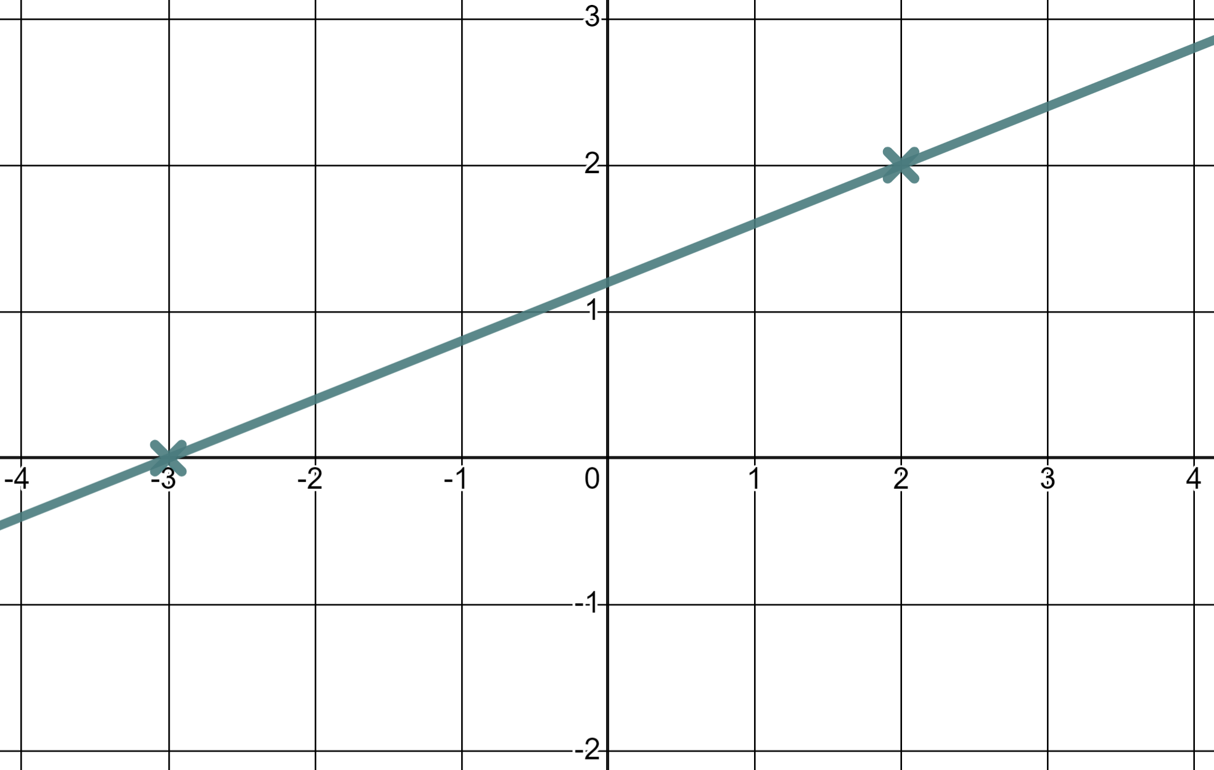
Efficiency in plotting
Sometimes we will see the form y = mx + c but the numbers will not be integer values.
For example, the linear equation y = 0.4x + 1.2
For example, the linear equation y = 0.4x + 1.2
x | −3 | −2 | −1 | 0 | 1 | 2 | 3
y | 0 |  |  |  |  | 2
x | −3 | −2 | −1 | 0 | 1 | 2 | 3
y
x | −3 | −2 | −1 | 0 | 1 | 2 | 3
y | 0 | 0.4 | 0.8 | 1.2 | 1.6 | 2 | 2.4
But there are two integer y-values in our table that we could accurately plot.

Slide 35
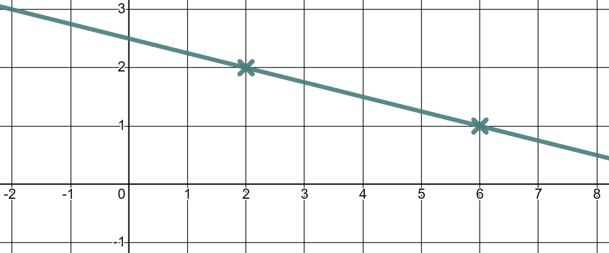

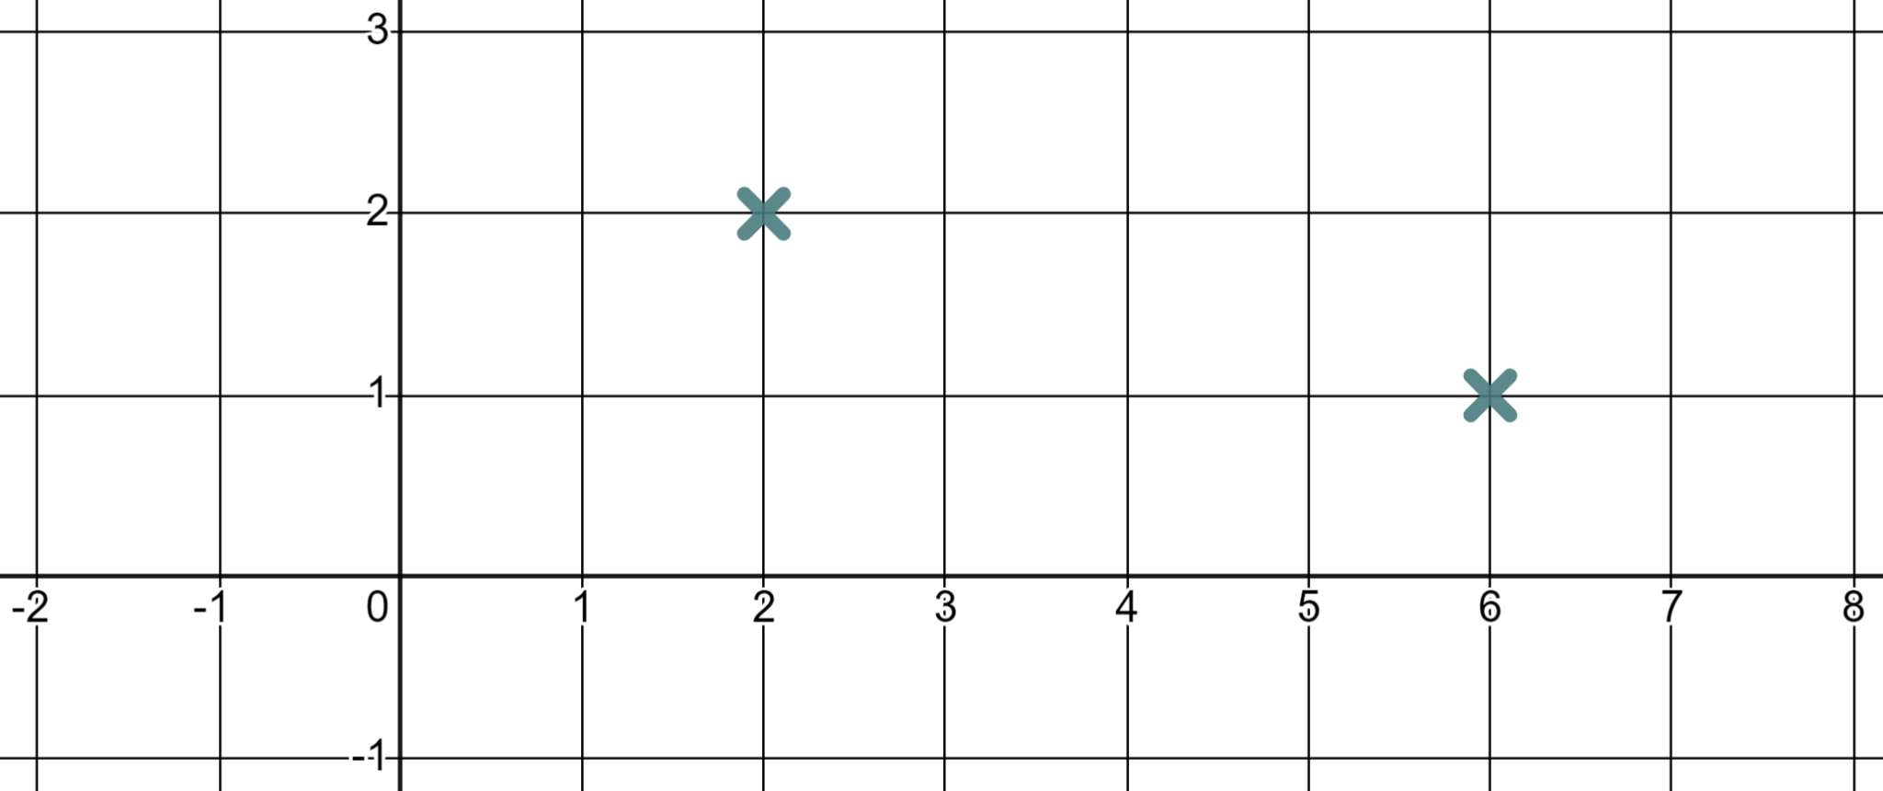
Efficiency in plotting
Which of these x-values will generate an integer y-coordinate for the linear equation y = 2.5 − 0.25x ?
Which of these x-values will generate an integer y-coordinate for the linear equation y = 2.5 − 0.25x ?
2.5 − 0.25(0) = 2.5
2.5 − 0.25(1) = 2.25
2.5 − 0.25(2) = 2
2.5 − 0.25(6) = 1
x = 0
x = 1
x = 2
Because 0.25 × 4 = 1 you know you’ll hit another integer y-value every increase of 4 in x
x = 6

Slide 36
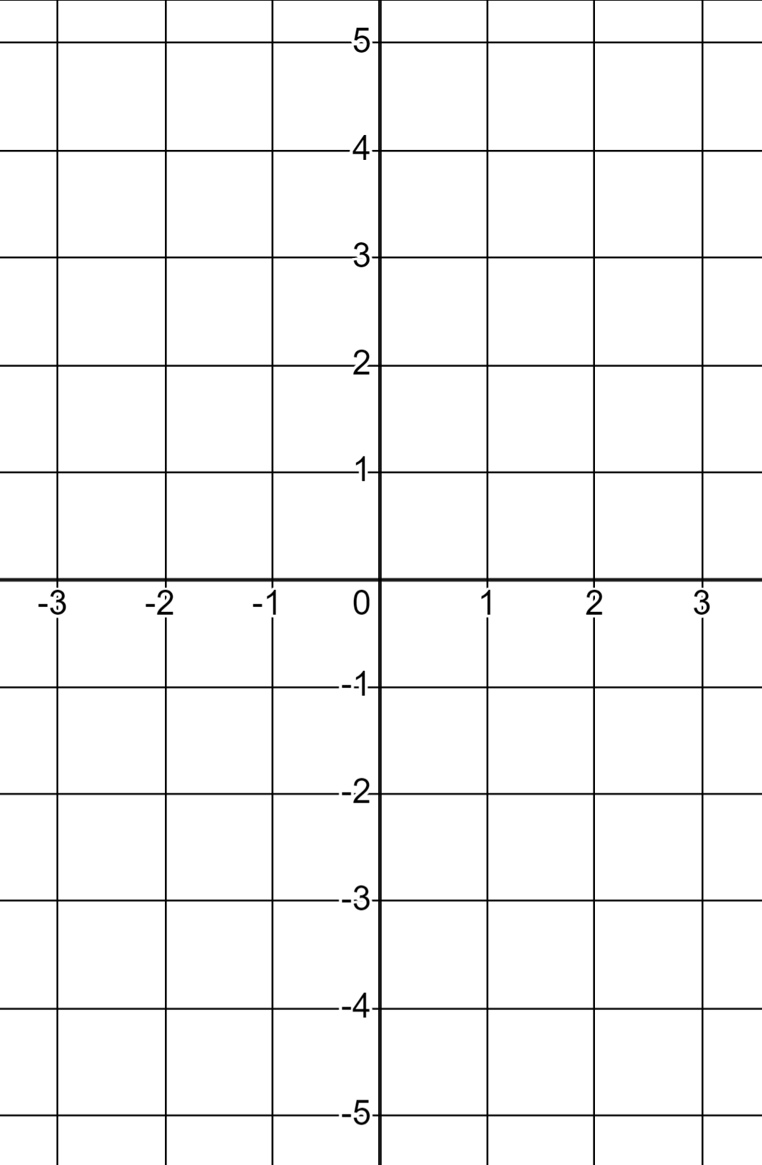
Efficiency in plotting
1) Find the coordinates for when x = 0 and when y = 0 thus draw the linear equations.
a) 3x + 2y = 6
b) 3x − 2y = 6
When x = 0
When x = 0
(0, 3)
(0, −3)
When y = 0
When y = 0
(2, 0)
(2, 0)

Slide 37
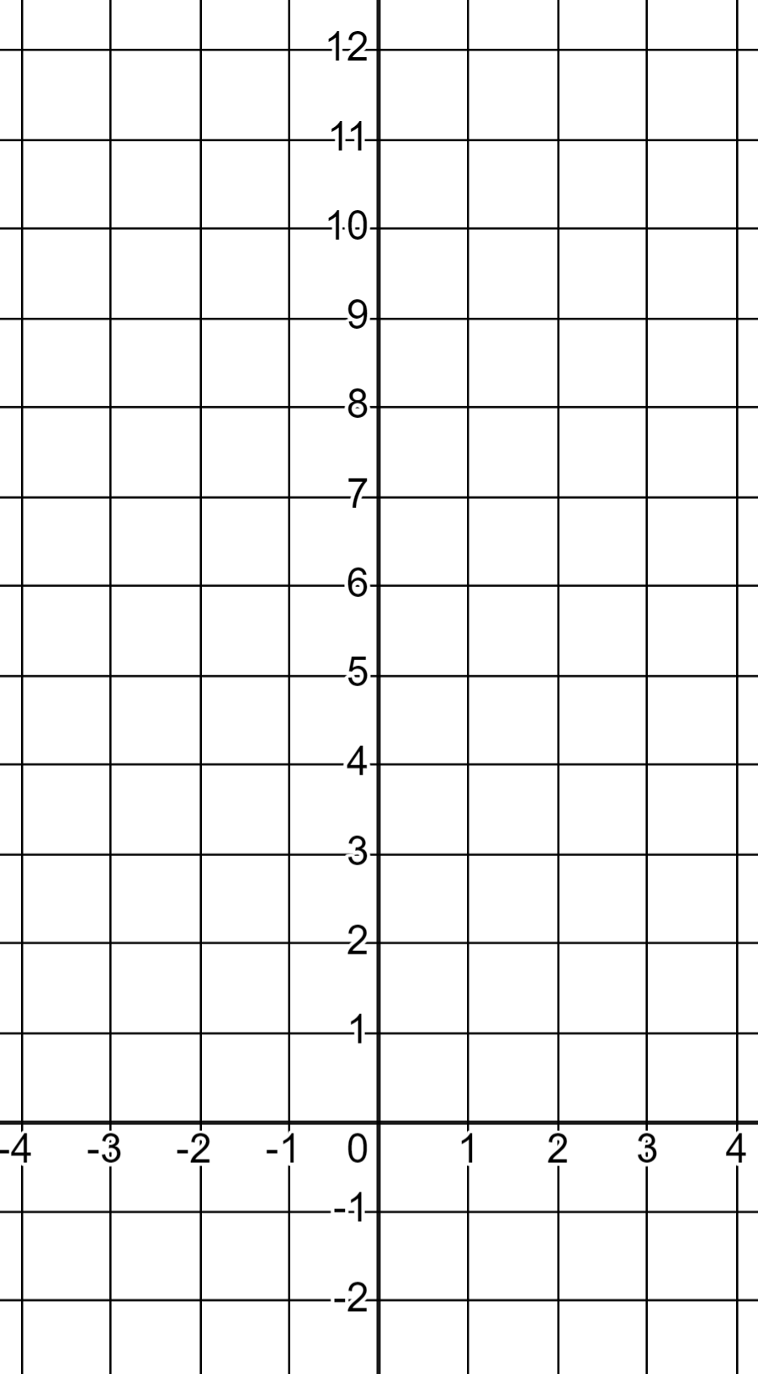
Efficiency in plotting
1) Find the coordinates for when x = 0 and when y = 0 thus draw the linear equations.
c) 9x + 3y = 27
d) 3y − 9x = 27
When x = 0
When x = 0
(0, 9)
(0, 9)
When y = 0
When y = 0
(3, 0)
(−3, 0)

Slide 38
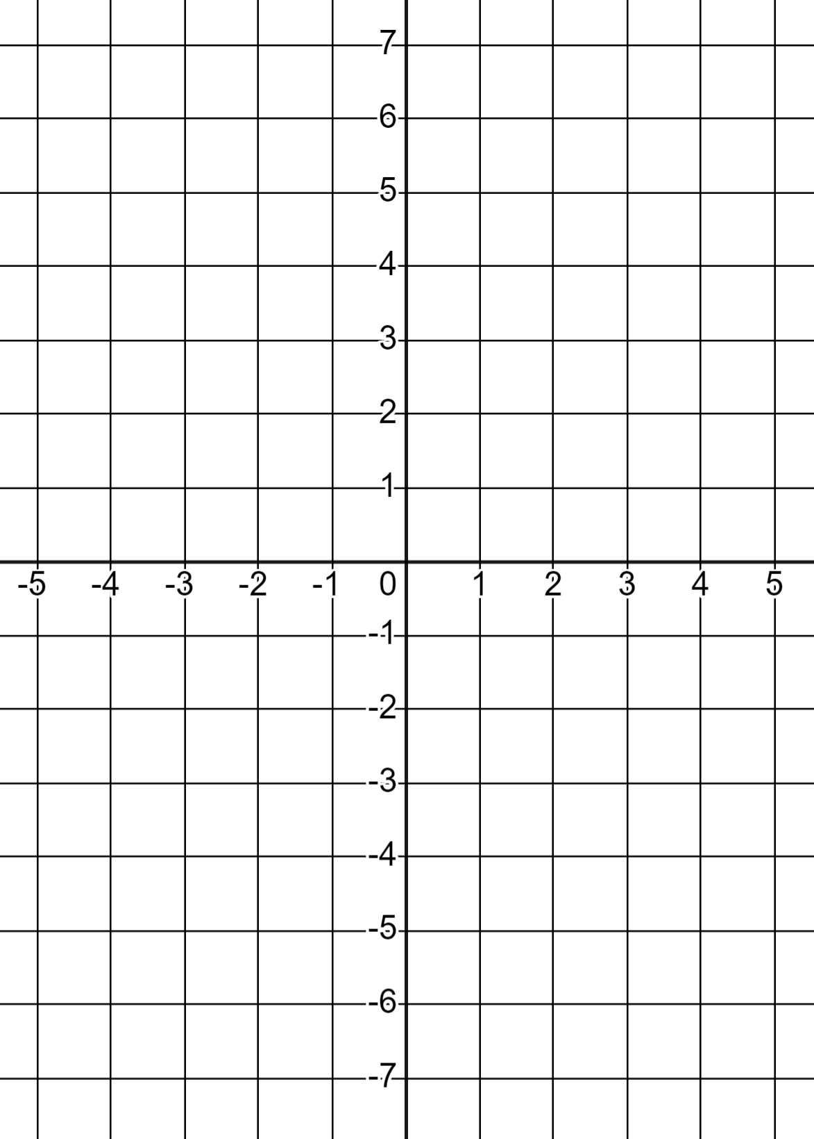
Efficiency in plotting
2) For each graph find two x-values that will give you integer y-values and draw the linear equations.
a) y = 0.8x − 3
b) y = 3.25 − 1.25x

Slide 39
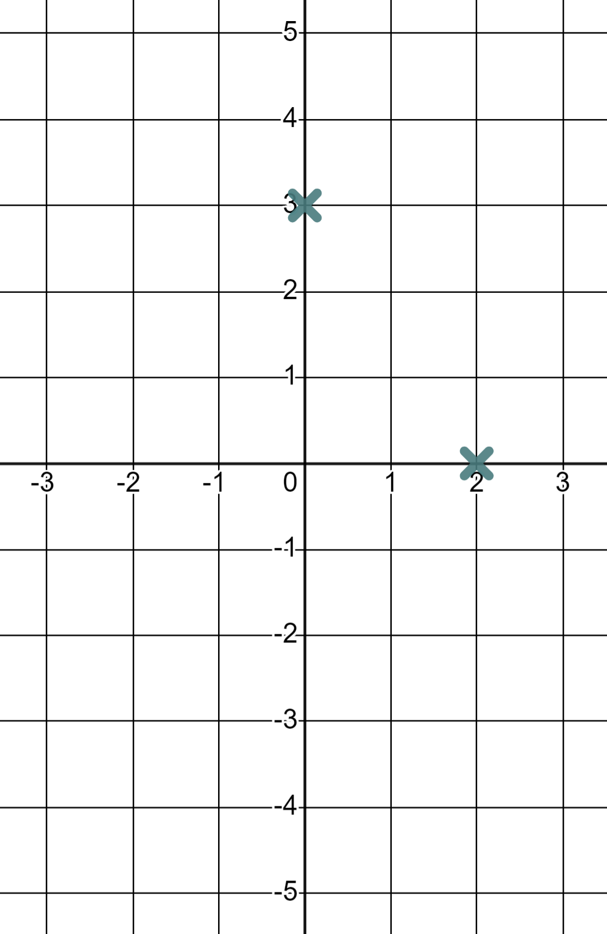
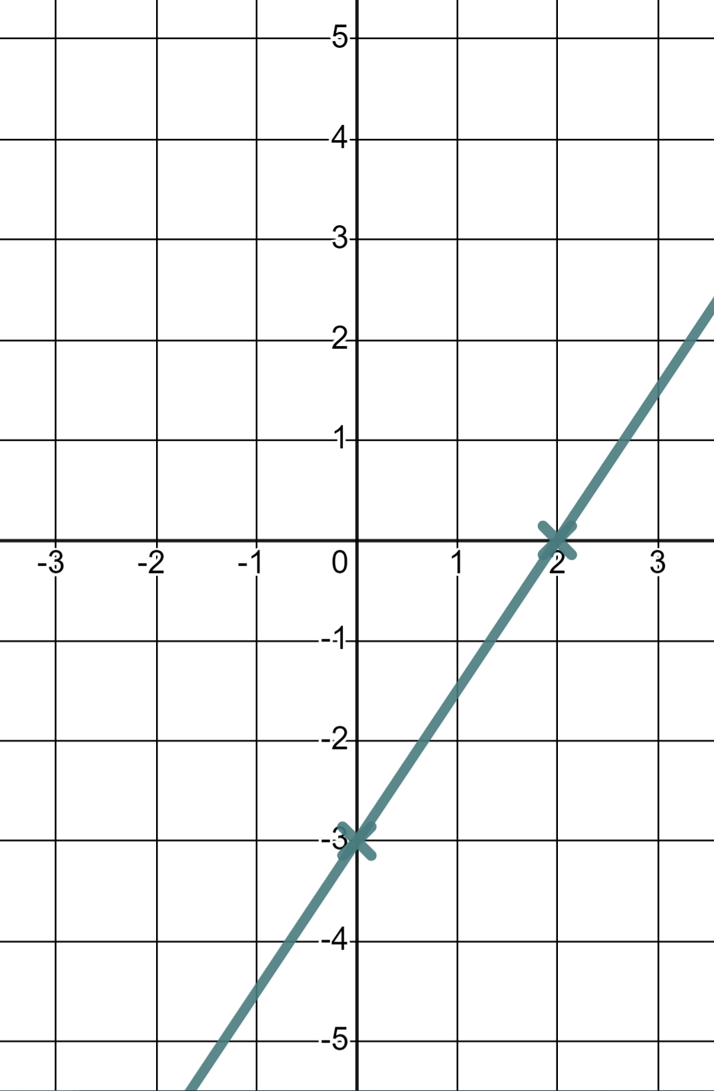
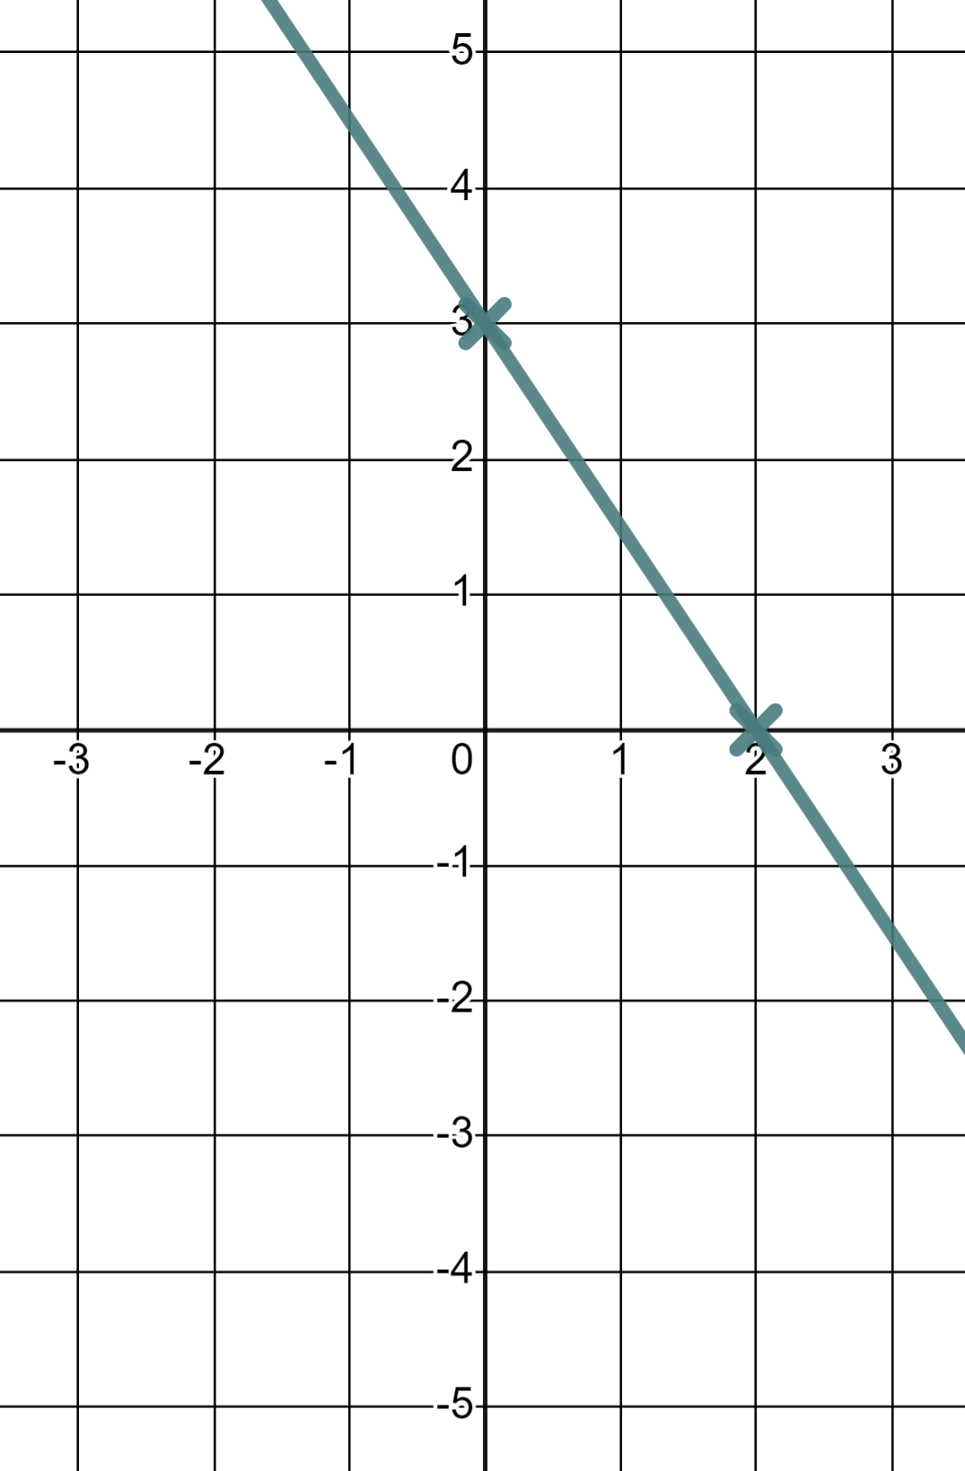
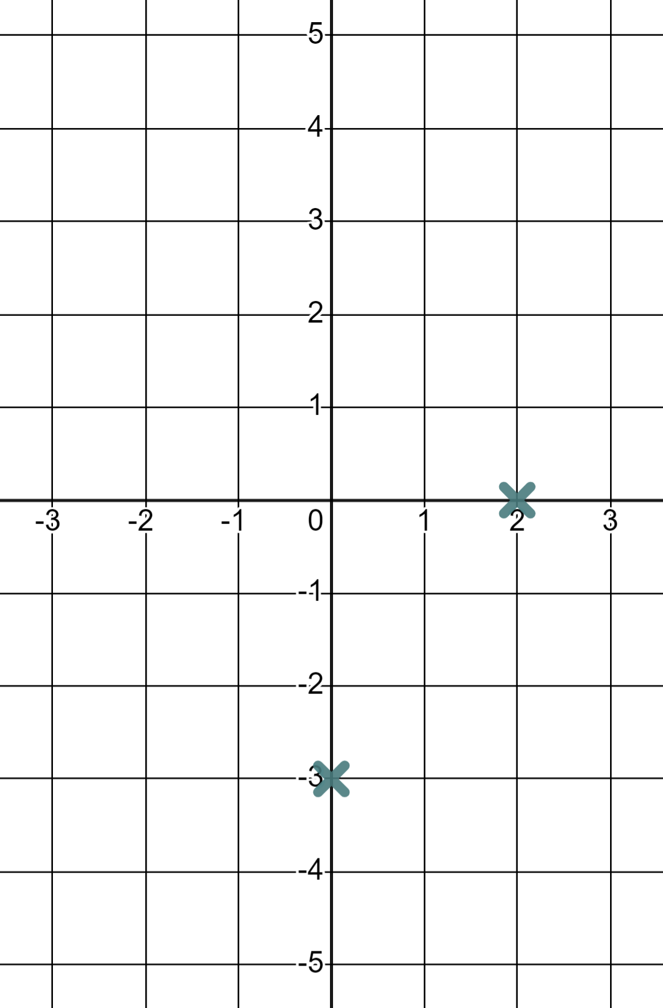
Efficiency in plotting
1) Find the coordinates for when x = 0 and when y = 0 thus draw the linear equations.
a) 3x + 2y = 6
b) 3x − 2y = 6
When x = 0
When x = 0
(0, 3)
(0, −3)
When y = 0
When y = 0
(2, 0)
(2, 0)

Slide 40
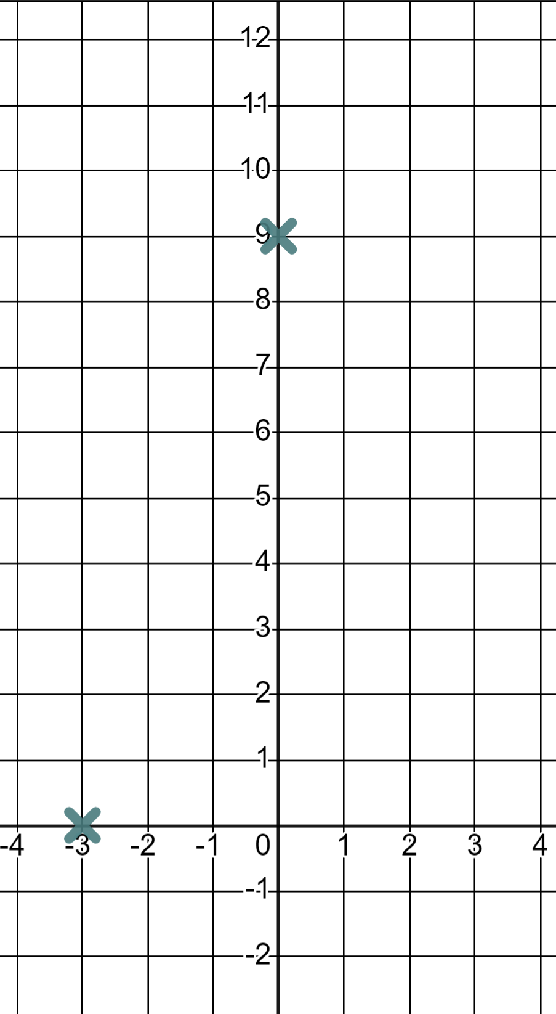



Efficiency in plotting
1) Find the coordinates for when x = 0 and when y = 0 thus draw the linear equations.
c) 9x + 3y = 27
d) 3y − 9x = 27
When x = 0
When x = 0
(0, 9)
(0, 9)
When y = 0
When y = 0
(3, 0)
(−3, 0)

Slide 41




Efficiency in plotting
2) For each graph find two x-values that will give you integer y-values and draw the linear equations.
a) y = 0.8x − 3
(0, −3)
(−5, −7)
(5, 1)
Then because 0.8, 1.6, 2.4, 3.2, 4, …you know you’ll hit another integer for every change of 5 in x
b) y = 3.25 − 1.25x
(1, 2)
(5, −3)
(−3, 7)
Then because 1.25, 2.5, 3.75, 5, …you know you’ll hit another integer for every change of 4 in x

Slide 42
Efficiently drawing linear graphs
We don’t always need a complete table of values to draw a linear graph. They can be drawn more efficiently with just two coordinates because of the nature of their straight line form.
To draw them accurately the distance between the two points should not be too small.
You should check your calculations carefully if you use less points.

Slide 43

© Oak National Academy 2024.
Produced in partnership with Mathematics in Education and Industry.
Licensed on the Open Government Licence v3.0, except where otherwise stated. See Oak terms and conditions.

